Slide 1
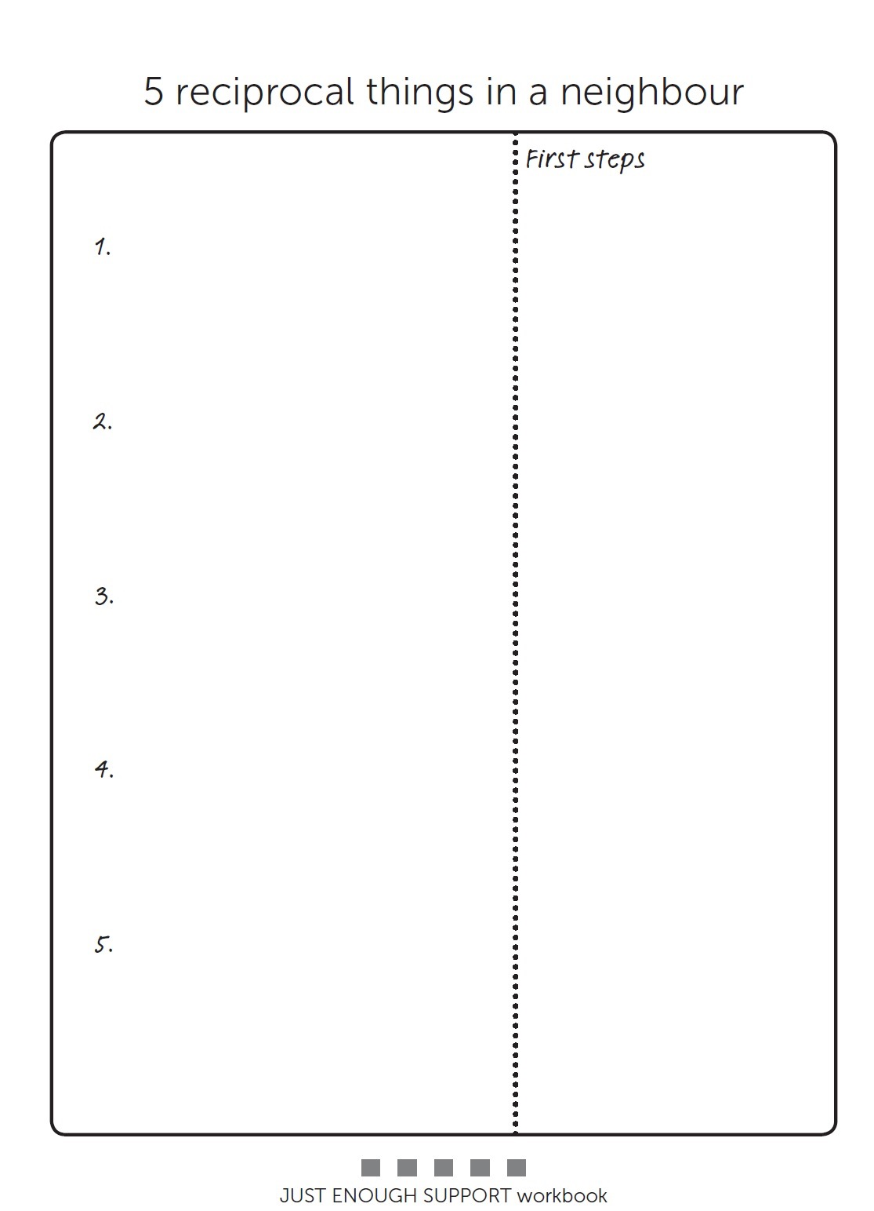
Paul
Shopping for the neighbours. Offering lifts, putting a bet on.
Dog walking for others.
Growing produce or gardening.
Taking in garbage bins.
House minding, holding the key. Be a more active member of home watch.

Slide 2
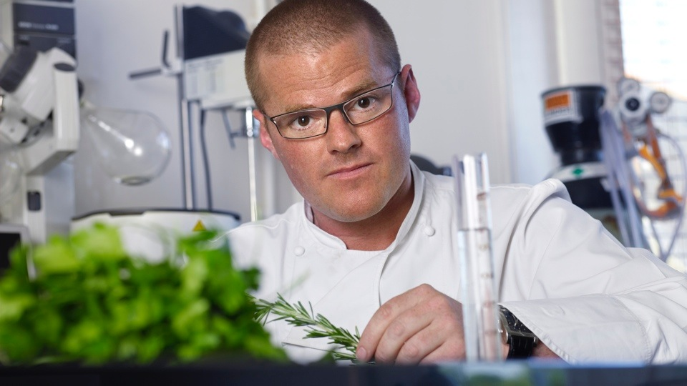
Radical
Notes:
Radical - get people to blue sky think about ideas that are radical, traditional and different. Then pick the ones that seem possible to implement.

Slide 3
Traditional

Slide 4
Different

Slide 5
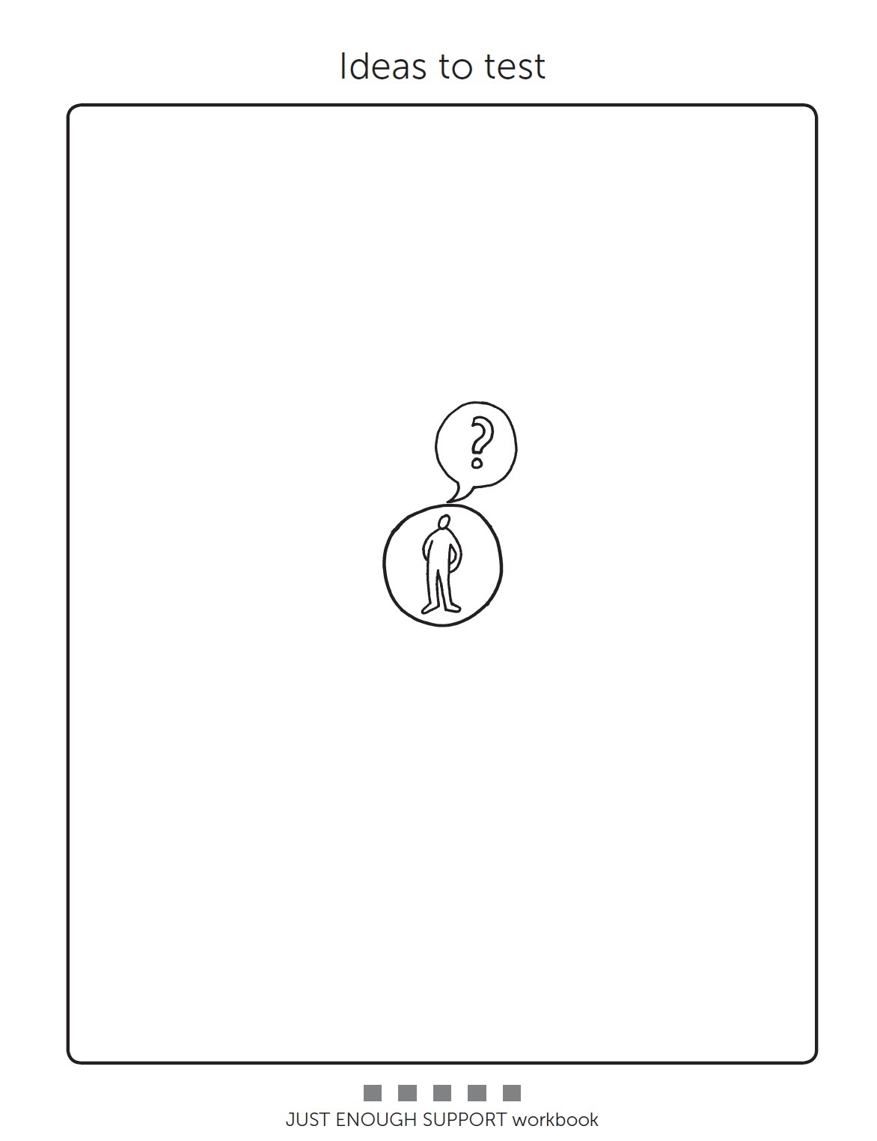
Going out independently
Get more involved in home watch.
More involvement
in health and safety
Epilepsy sensor
Just checking system
Time alone
Night time support reduced
New phone
Going out with Poppy
Stranger danger
Advertise produce
Shopping for Neighbours
Putting a bet on for someone
Assistive technology on front door

Slide 6
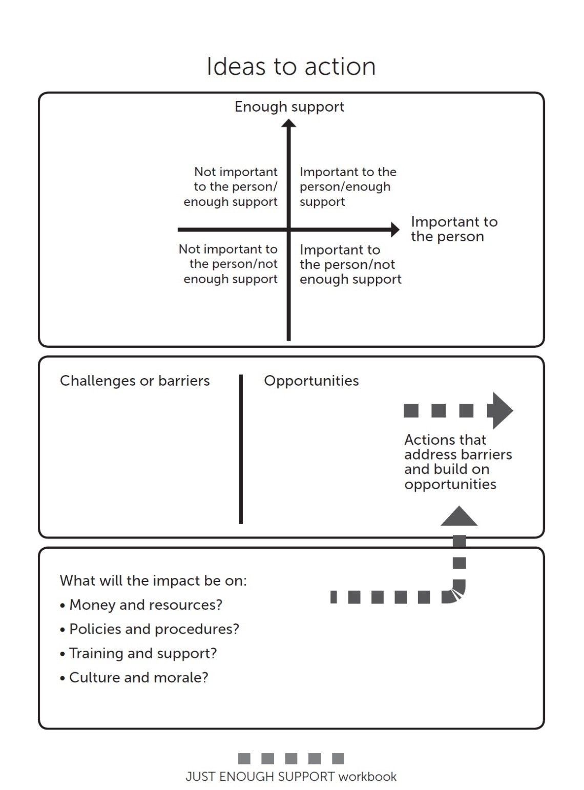
Testing ideas

Slide 9
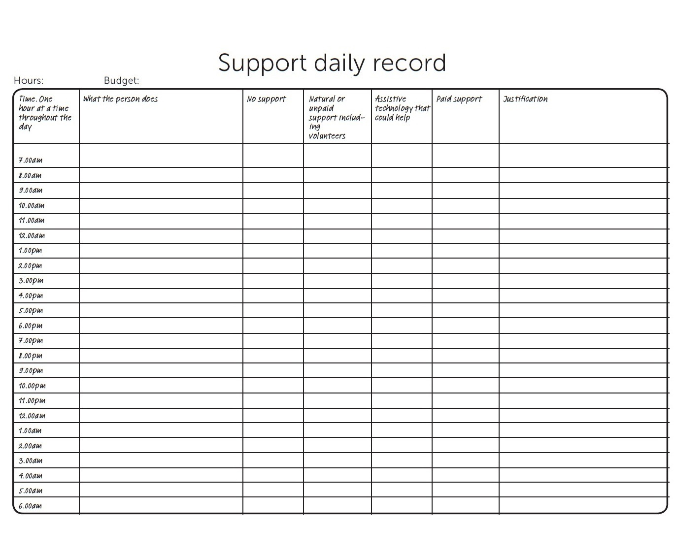

Slide 11
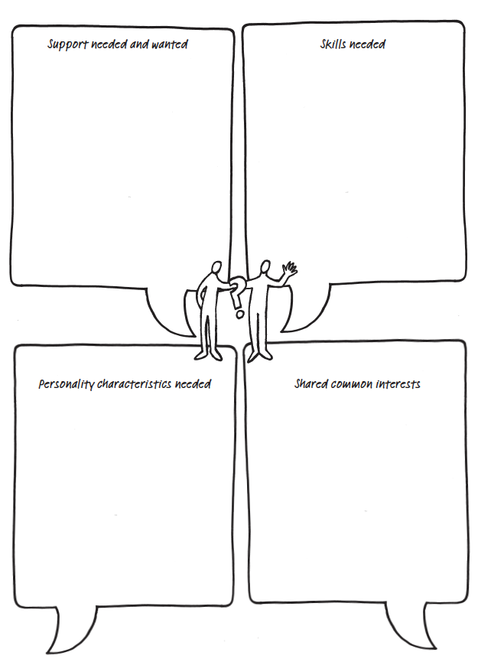

Slide 13
How are the new supports working out?
Person-Centred Review

Slide 14
Capturing Learning/Evaluate Progress
Learning Logs
4+1 Questions
Working/Not working

Slide 17
Barb Swartz-Biscaro
barbs@hsacanada.ca
www.hsacanada.ca
/http://www.facebook.com/pages/Helen-Sanderson-Associates/
pages/Helen-Sanderson-Associates/
@HSACanada1
http://www.youtube.com/user/helensandersonHSA

