Slide 1
Choice and Balance
As we think about choice, we can see
  - All choice can be irresponsible (happy and dead)
  - And dictating lifestyle is unacceptable (alive and miserable)
Good support means finding the balance
  - Finding the balance can create conflict
  - We all have a right to make choices, even bad choices
© TLCPCP 2019 www.tlcpcp.com

Slide 2
Control of the “W’s”
The Person has positive control over the “w’s”
  What, Where, When, Why and With whom
The Person decides the “how”
© TLCPCP 2019 www.tlcpcp.com

Slide 3
Choice
A Key to Positive Control
Choice is not picking between two options (this or that)
Choice has limitations and impact (understanding them)
The person must find the options appealing to them
Adapted from TLCPCP 2019 www.tlcpcp.com
Notes:
TLC-PCP www.learningcommunity.us

Slide 4
Choice has Boundaries for Everyone
Imposed by society
  Laws
  Expectations/values
My values
  What is and is not OK for me and those I trust
Ripple effect - One choice creates boundaries on other choices
  My relationships
  The work I do
  Where I live
Resource Driven
  Financial – how much time or money I have available
Risk involved
The difference is when the boundaries are set for the convenience of the system therefore limiting choices that meet the person’s desires: Operating hours, staff available, policies or procedures.
© TLCPCP 2019 www.tlcpcp.com

Slide 5

Support vs Overprotecting

Slide 6
Of course, some risk is just not okay

Slide 7
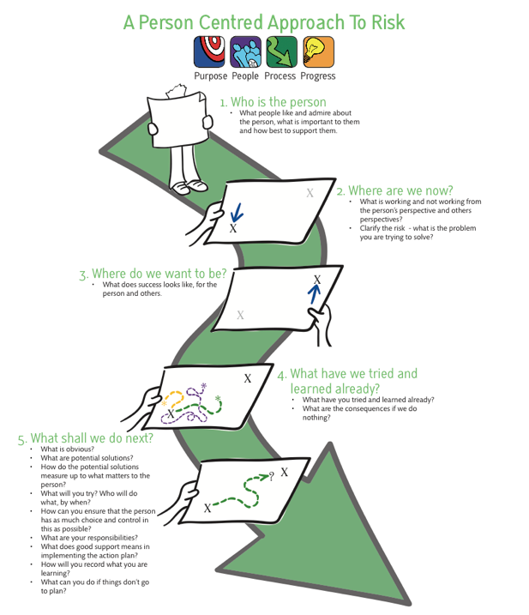

Slide 8


What are you struggling to balance?
Notes:
8

Slide 9


Slide 10
2 Minute Drill
Imagine…
You have just been hired by a company that prides itself in supporting its employees.
They want to know the key things that you find helpful to be a productive employee.
You want to give them an overview, a summary in 2 minutes, of what they need to know to support you successfully.
What would you say?
© TLCPCP 2019 www.tlcpcp.com
Notes:
TLC-PCP www.learningcommunity.us

Slide 11
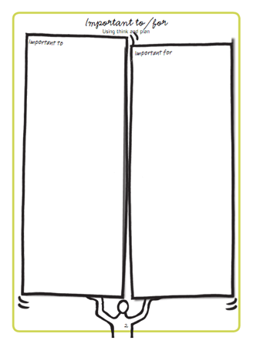
Activity
What is important to you and important for you at work?

Slide 12
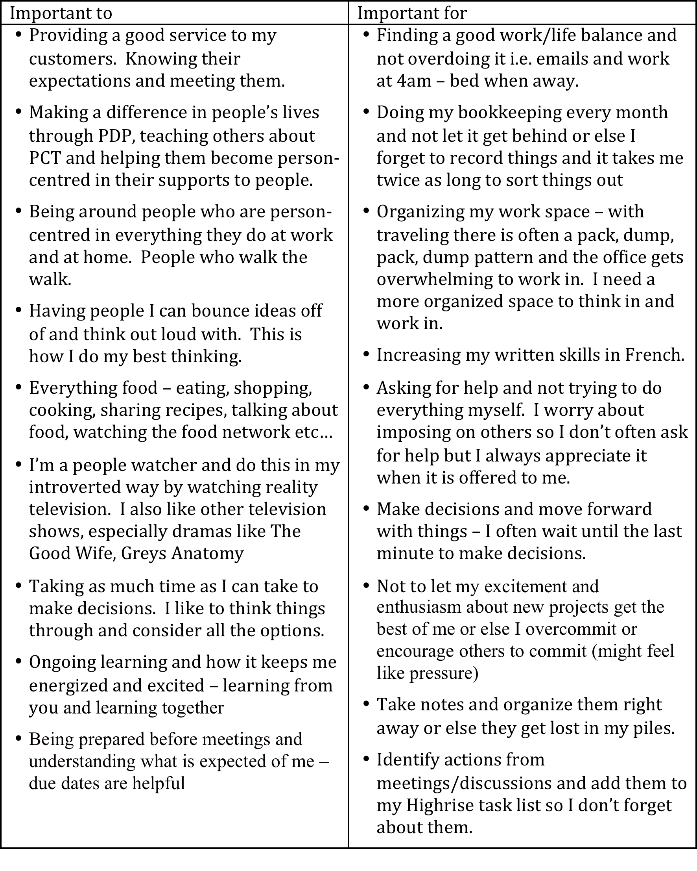

Slide 13

This is an awareness test…

Slide 14
Harry
What is important to Harry | What is important for Harry
What else do we need to learn or know?
© TLCPCP 2019 www.tlcpcp.com

Slide 15
Harry – Possible Answers
What is important to Harry | What is important for Harry
To attract women To spend his money as he wants To know what George thinks (his opinion) | To learn what to wear that will cause minimal pain and embarrassment To learn to manage his money
What else do we need to learn or know? What does Harry understand about – Managing his money Attracting women, dating Where it is appropriate to wear what
© TLCPCP 2019 www.tlcpcp.com

Slide 16
Moving from Service Life to Community Life
Service
Life
A Good Paid
Life
Community
Life
‘Important to’ recognized
Focus on connecting,
building relationships
and natural supports
‘Important to’ present
‘Important for’ addressed
No organized effort to address ‘important to’
‘To’ and ‘for’ present
Closest people are
paid or family
Few real connections
‘To’ and ‘for’ present
Recognized for their contributions and valued participation
Are known and welcomed
© TLCPCP 2019 www.tlcpcp.com

Slide 17
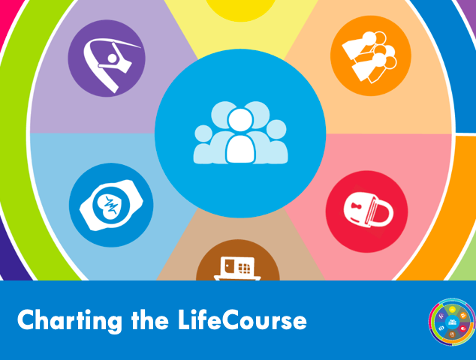

Slide 18
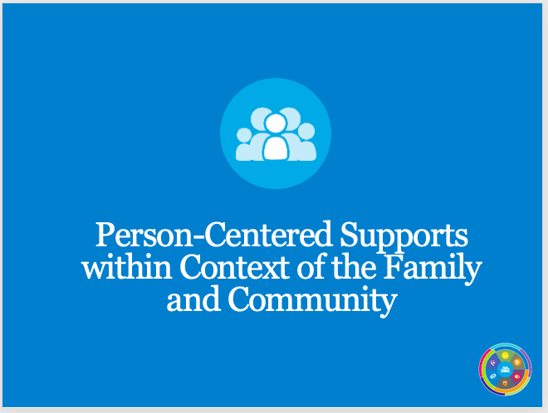

Slide 19
Vision & Trajectory for a Good Life
Friends, family,
enough money,
job I like, home, faith, vacations, health, choice, freedom
Trajectory towards Life Outcomes
Trajectory towards things unwanted
Vision of What I Don’t Want
Notes:
.

Slide 20






Person’s Perspective
Trajectory towards Good Life
I want to live in my own place,
Have a girlfriend/boyfriend,
Get married, A job
Work in a place where I’m not made fun of,
Friends, Make my own decisions
Trajectory towards Life Outcomes
Vision of What I Don’t Want
Drama, To be bossed around,
Made fun of,
Called the “R” word, Bullied
©UMKC Institute for Human Development lifecoursetools.com

Slide 21
Family’s Perspective
Trajectory towards Good Life
I want them to be happy
Safe
Someone who loves them other than family
Friends
Trajectory towards Life Outcomes
Vision of What I Don’t Want
Them taken advantage of:
Emotionally, sexually, financially
Made fun of/bullied
Them to be Lonely
Living in Poverty
Institutionalized
©UMKC Institute for Human Development lifecoursetools.com

Slide 22
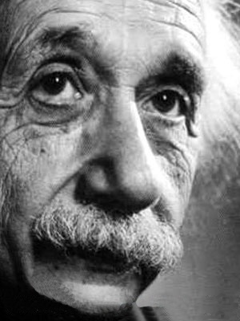
“If I had an hour to save the world, I’d spend 55 minutes defining the problem.”
© TLCPCP 2019 www.tlcpcp.com

Slide 23


Slide 24
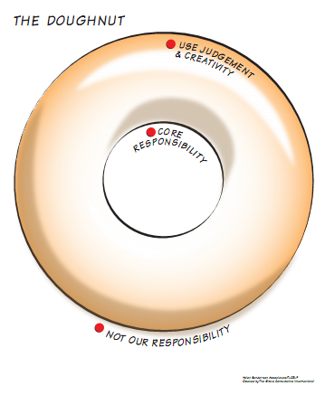

Slide 25
Harry – George’s doughnut
Core
responsibilities
Use judgment
and creativity
Not our paid
responsibility
© The Learning Community for Person centred Practices, Inc. 2008

Slide 26
Harry – George’s doughnut
Core
responsibilities
To help Harry make
an informed choice –
About the shirt
About his money
It starts with asking
why he wants
the shirt
Use judgment
and creativity
What you do/try
to help Harry make
an informed choice
about –
The odds against
the shirt being a
“chick magnet”
Spending ½ his money
for 2 weeks on
1 purchase
Not usually our
responsibility
Whether or not
he buys the shirt.
© TLCPCP 2019 www.tlcpcp.com

Slide 27
Harry #2 – new information
What is important to Harry | What is important for Harry
What else do we need to learn or know?
© TLCPCP 2019 www.tlcpcp.com

Slide 28
Harry #2 – add new information
What is important to Harry | What is important for Harry
To be around this woman, have her “recognize” that she wants him. To have control and power over her. | To know the legal consequences of stalking To stop stalking To understand that stalking doesn’t work to get an intimate relationship
What else do we need to learn or know? More about the past history of this or similar behaviour? How dangerous is he? Does he get what we think he gets out of stalking? Has he ever had a “regular adult” relationship?
© TLCPCP 2019 www.tlcpcp.com

Slide 29
Harry #2 – Executive Director’s doughnut
Core
responsibilities
Use judgment
and creativity
Not our paid
responsibility
© TLCPCP 2019 www.tlcpcp.com

Slide 30
Harry #2 – Executive Director’s doughnut
Core
responsibilities
Short term -Keep the
woman safe and in
the process keep him
safe (and out of jail)
Longer term – teach
relationship SKILLS,
figure out why he is
stalking, any pattern,
and deal with it,
seeking a way for
Harry to live safely
in the community
Use judgment
and creativity
Short term – How
you keep the woman
safe until you can get
him treatment
Longer term – how
you learn, acting on
what you learn,
figuring out how he
can get what is
important enough to
him that that he
will participate in
treatment
Not usually our
responsibility
To help him get
sex or keep him out
of jail at all costs
© TLCPCP 2019 www.tlcpcp.com

Slide 31
Moving from Service Life to Community Life
Service
Life
A Good Paid
Life
Community
Life
Focus on connecting,
building relationships
and natural supports
‘Important to’ recognized
Harry
‘Important to’ present
‘Important for’ addressed
No organized effort to address ‘important to’
‘To’ and ‘for’ present
Closest people are
paid or family
Few real connections
‘To’ and ‘for’ present
Recognized for their contributions and valued participation
Are known and welcomed
© TLCPCP 2019 www.tlcpcp.com

Slide 32
Moving from Service Life to Community Life
Service
Life
A Good Paid
Life
Community
Life
‘Important to’ recognized
Harry
Focus on connecting,
building relationships
and natural supports
‘Important to’ present
‘Important for’ addressed
No organized effort to address ‘important to’
‘To’ and ‘for’ present
Closest people are
paid or family
Few real connections
‘To’ and ‘for’ present
Recognized for their contributions and valued participation
Are known and welcomed
© TLCPCP 2019 www.tlcpcp.com

Slide 33
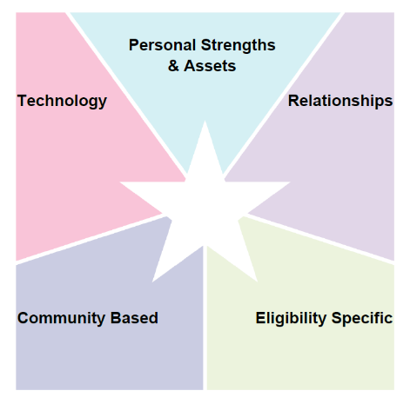
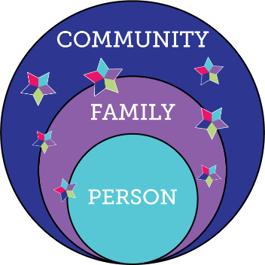

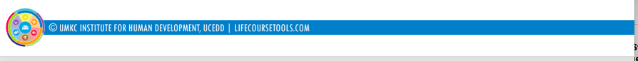
Integrated Support Star
What We Want To See…
resources, skills, abilities
i-pad,computer,
smart phone apps, remote monitoring, cognitive accessibility,
Adaptive
equipment
family, friends, neighbors, co-workers, church members, community members
school, businesses, church faith based, parks & rec, public transportation
SHS services, Special Ed, Medicaid, Voc Rehab, Food Stamps, Section 8
R
100%

Slide 35
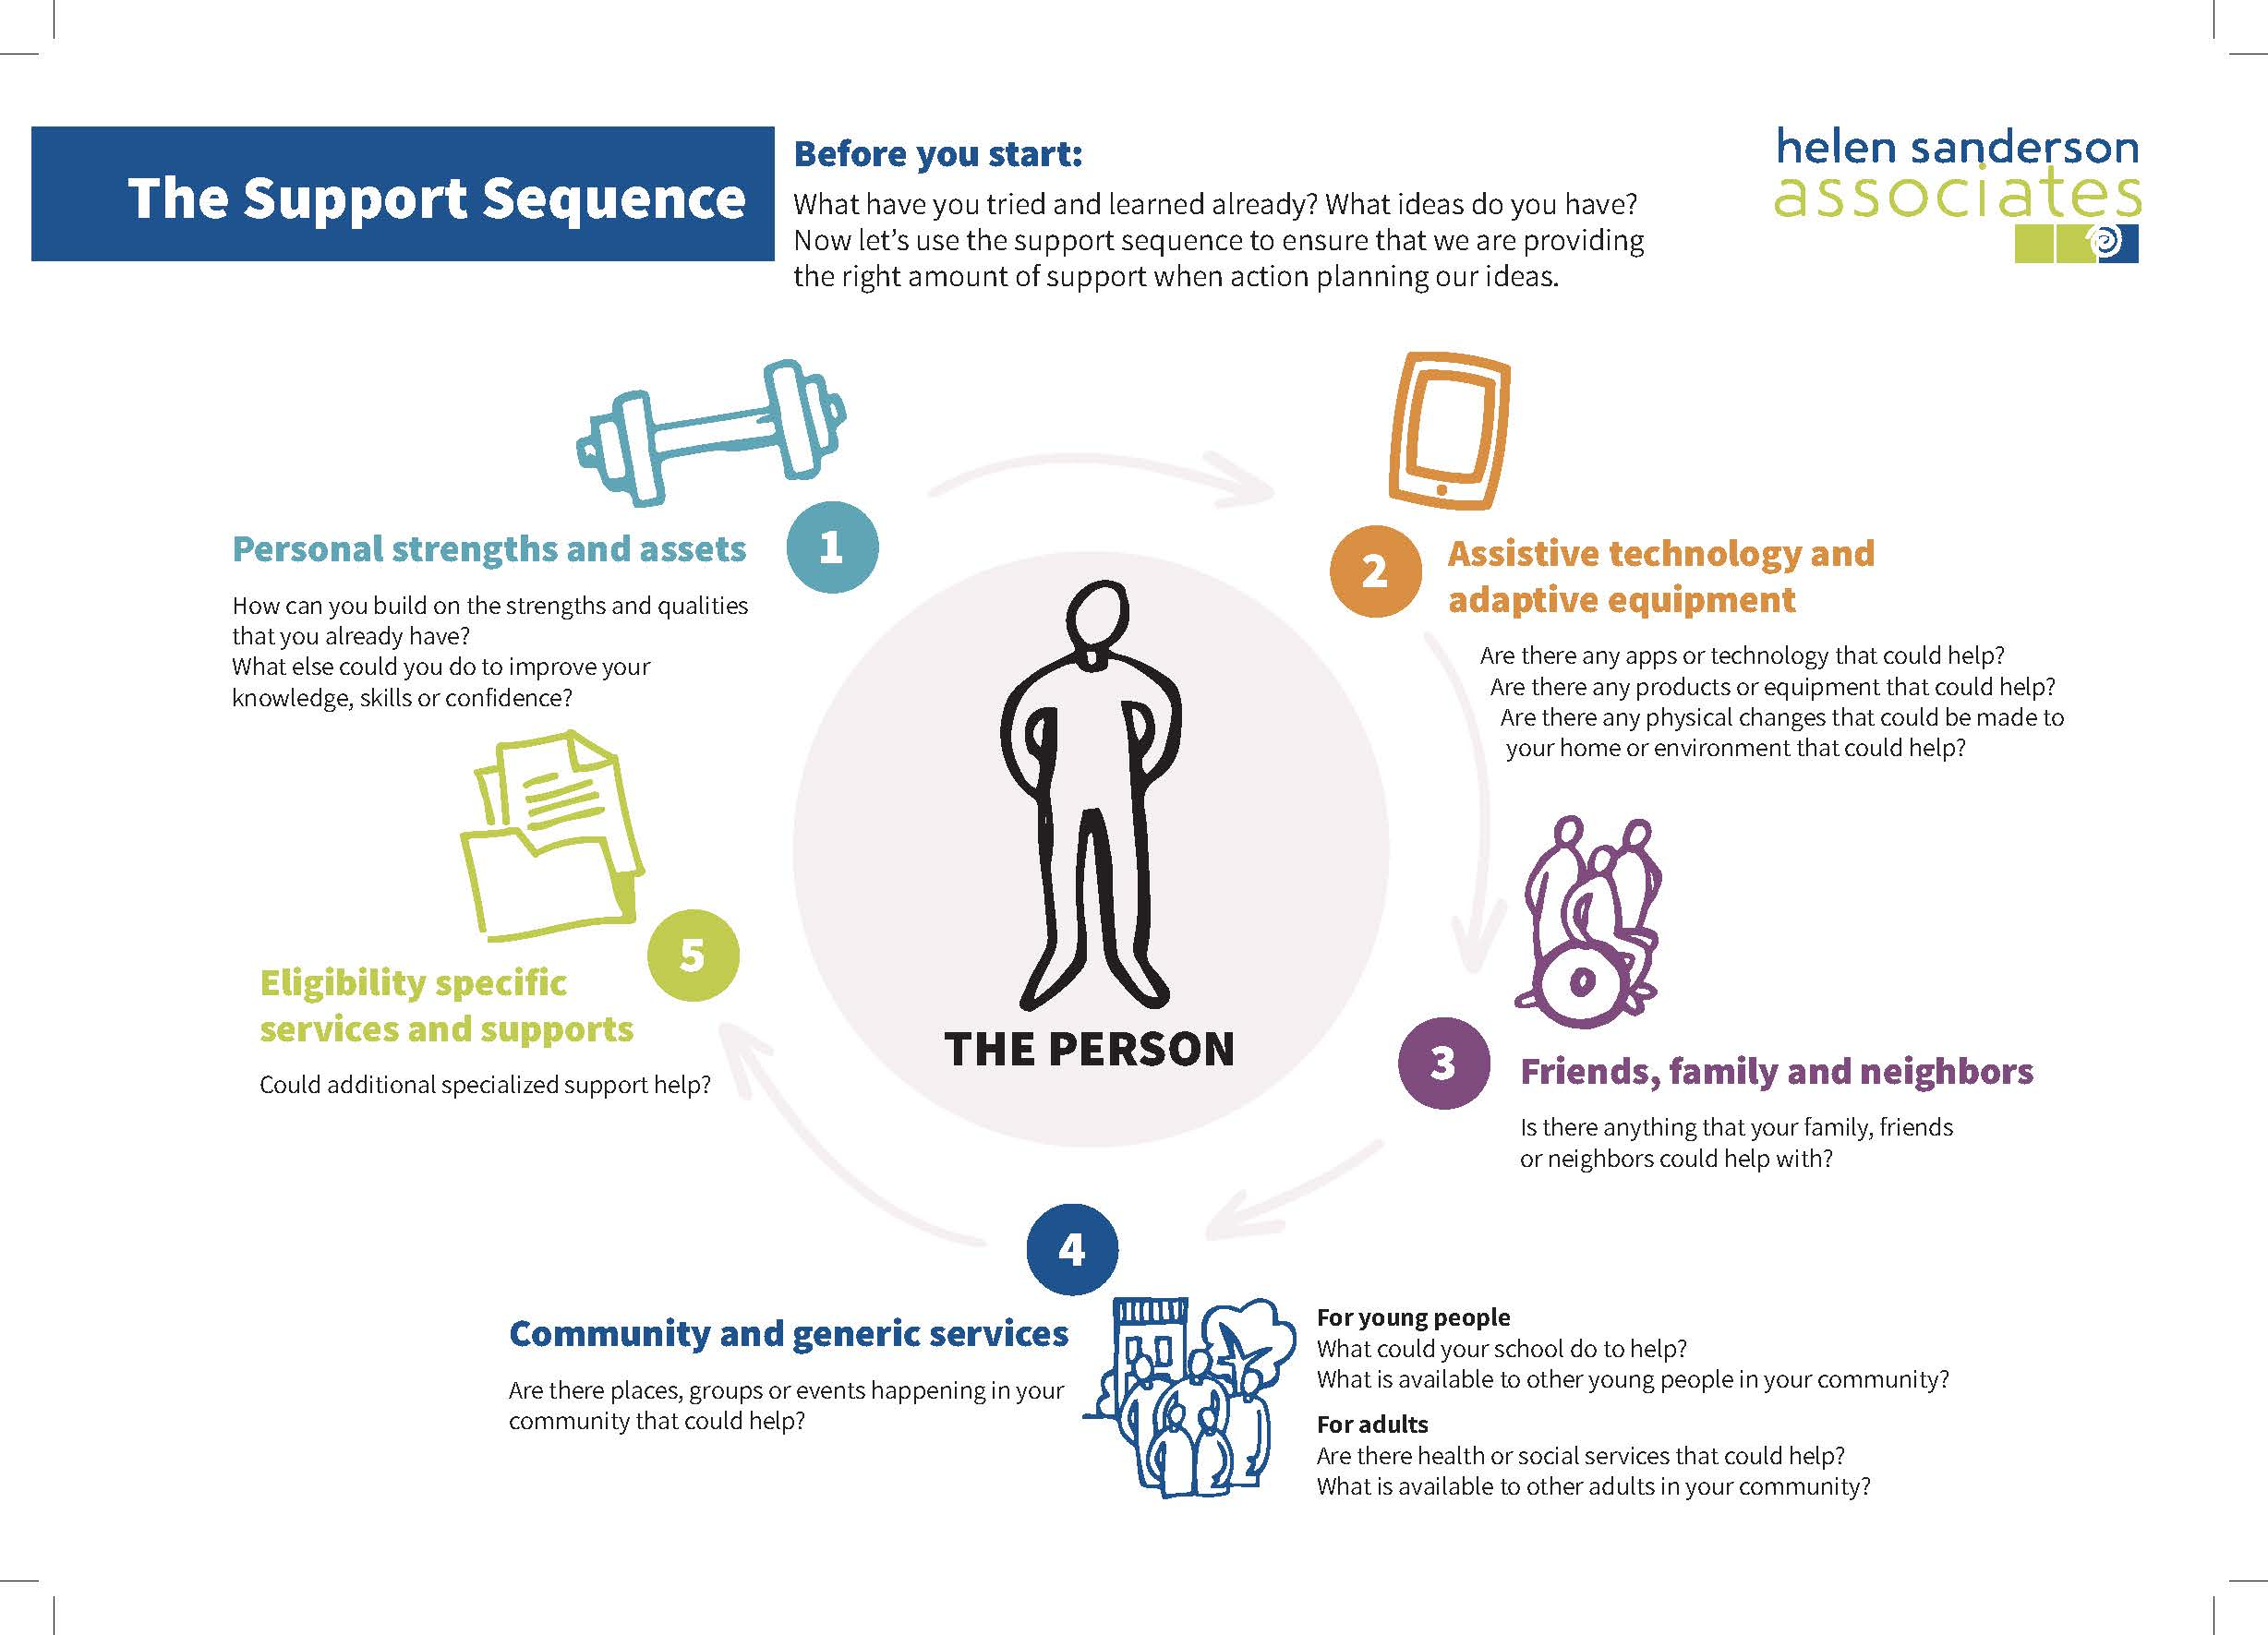
The support sequence

Slide 36
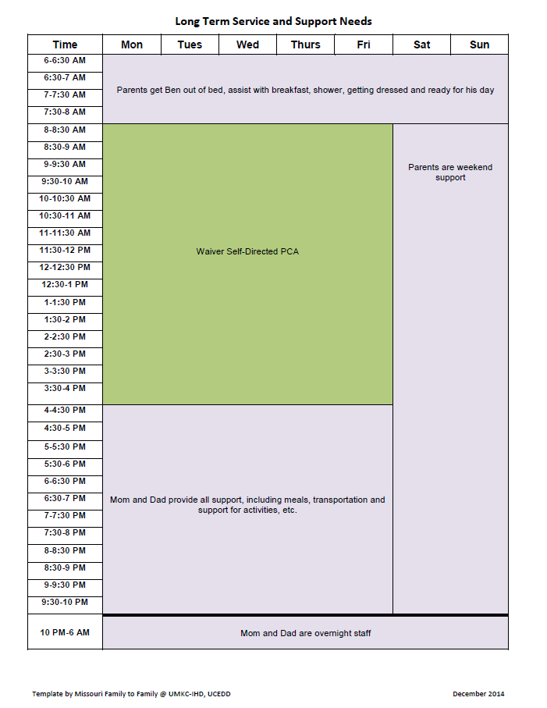
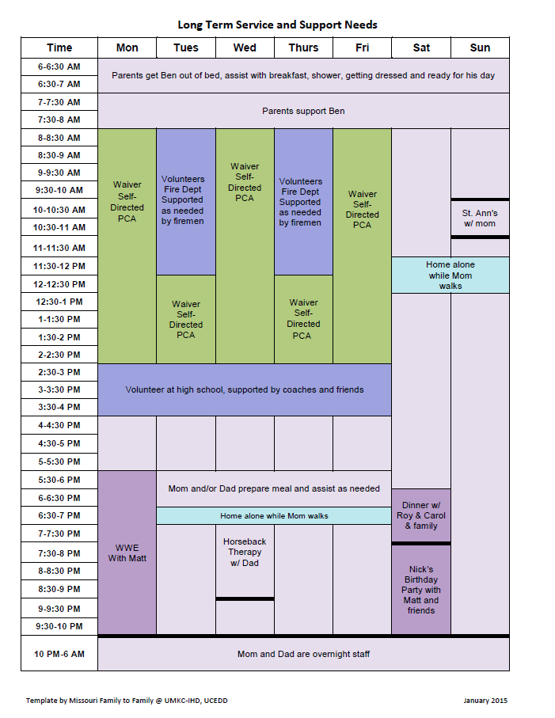
Integrated Supports
Paid supports

Slide 37
Ben’s integrated supports

Slide 38
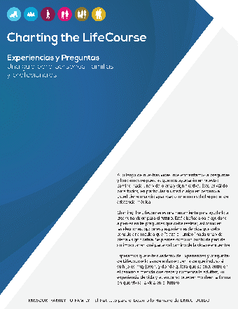

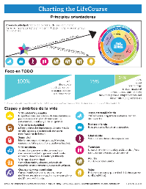
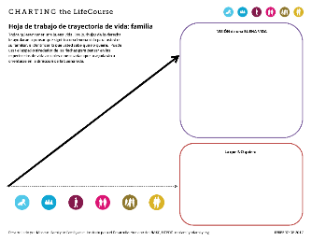
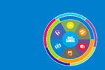
Charting the LifeCourse Framework and Tools
Charting the LifeCourse Resources:
Find CtLC webinars, resources and tools on lifecoursetools.org
Learn from others who are using CtLC on the Facebook Group: Charting the LifeCourse in Action
Follow the latest updates or opportunities on the Facebook page: lifecoursetools.com
Attend the Annual Charting the LifeCourse Showcase for 2 days of learning and sharing in Kansas City, MO
Connect with your state Community of Practice on Supporting Families team supportstofamilies.org
Contact umkcCtLC@umkc.edu for more information.
lifecoursetools.com

Slide 39
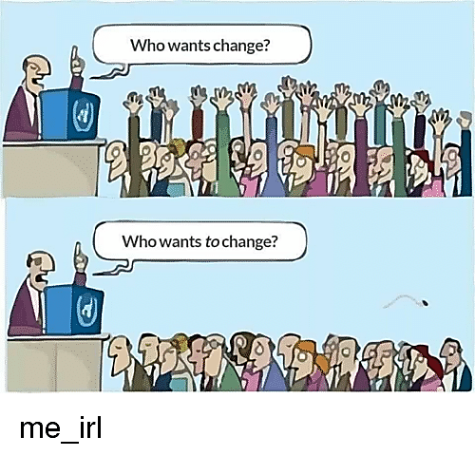
Change Agents AND Change Targets
© TLCPCP 2019 www.tlcpcp.com

Slide 40
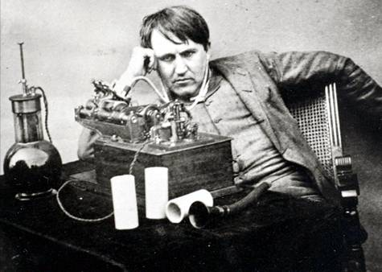
‘Discontent is the first necessity of progress’ -Thomas Edison
© TLCPCP 2019 www.tlcpcp.com

Slide 41
Discontent is the Engine of Change
There are 2 kinds of discontent
  Cynical discontent
  Optimistic discontent
© TLCPCP 2019 www.tlcpcp.com

Slide 42
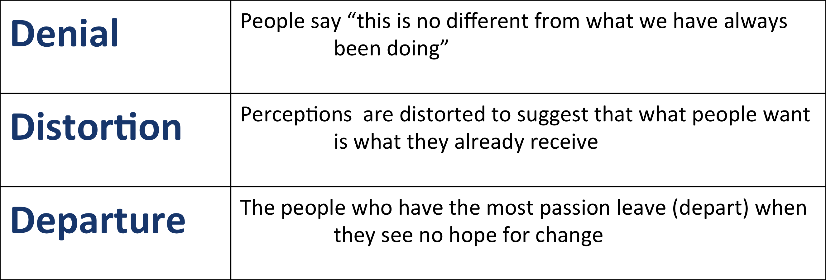
Cynical Discontent
  When you have discontent without hope
  you get cynical discontent which results in:
© TLCPCP 2019 www.tlcpcp.com

Slide 43
Optimistic Discontent
Requires hope based on trust that is created when there is:
A history of acting on things that can be changed
Honesty about those things that will take time to change
Progress in acting on the things that take time
Where cynical discontent is dominant
…trust must be created
© TLCPCP 2019 www.tlcpcp.com

Slide 44
Levels of Change
Any change that results in a positive difference in the lives of people who use services or in your own work life.
Level 1
Any changes an organization makes to it’s practices, structure or rules that result in positive differences in the lives of people.
Level 2
Any change in practice, structure and rules made at the system level. These changes have an effect on many organizations, and therefore many peoples’ lives.
Level 3
© TLCPCP 2019 www.tlcpcp.com

Slide 45
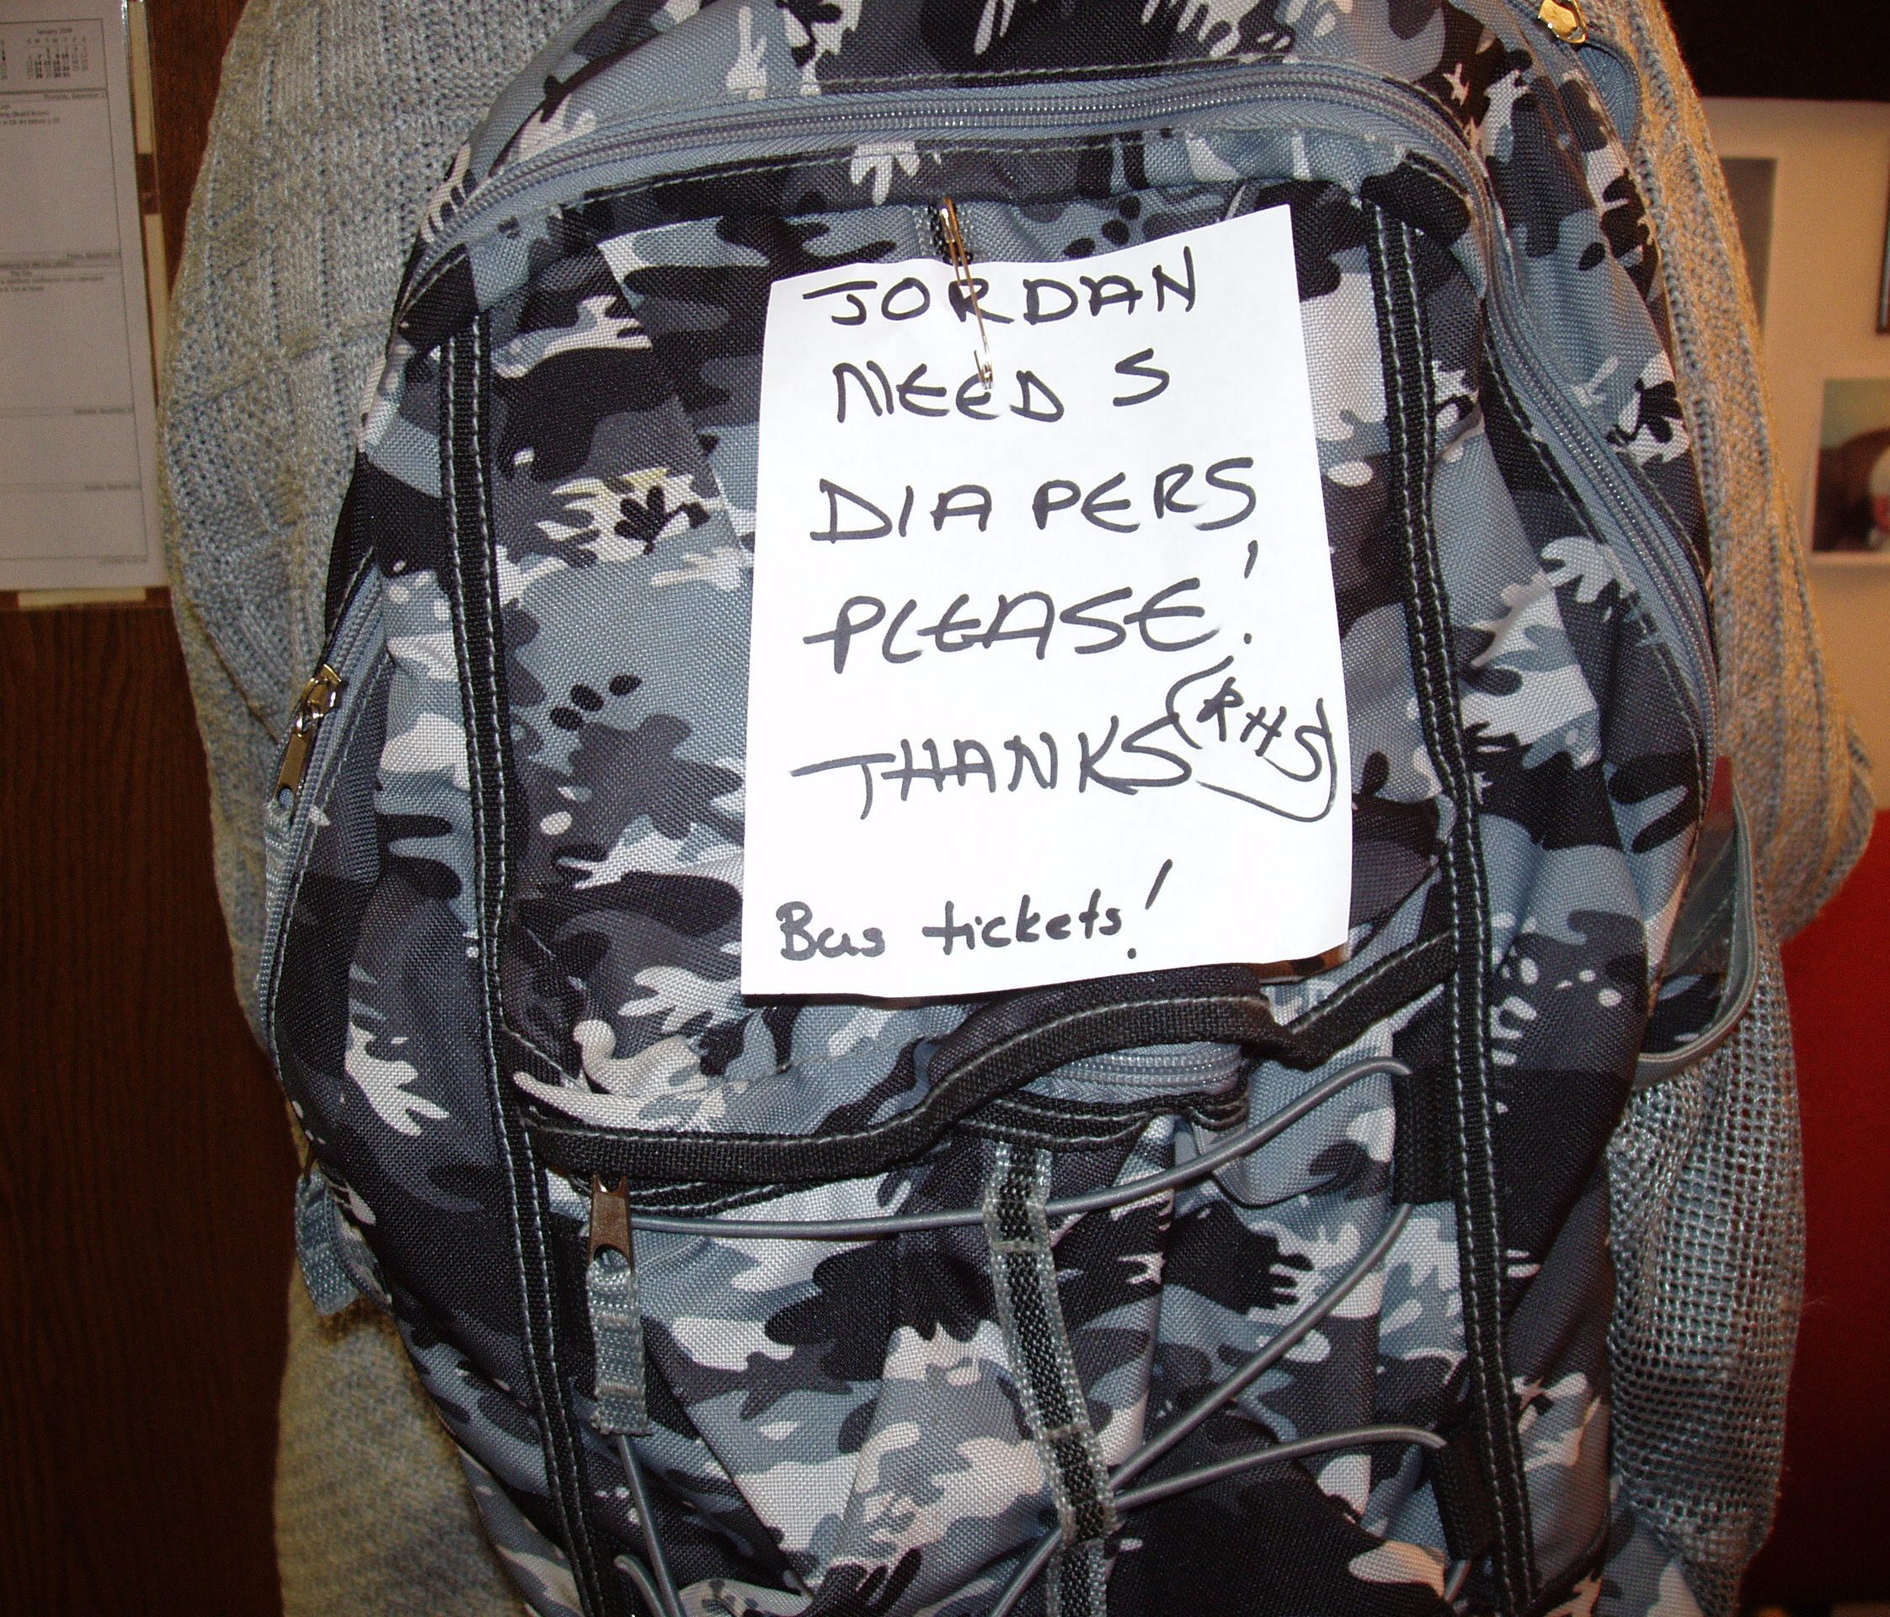

Slide 46
When we listen…
Communication becomes more complex
People become more interested in other ways of communicating
Some people who didn’t use words to communicate start doing so
© TLCPCP 2019 www.tlcpcp.com
Notes:
TLC-PCP www.learningcommunity.us

Slide 47
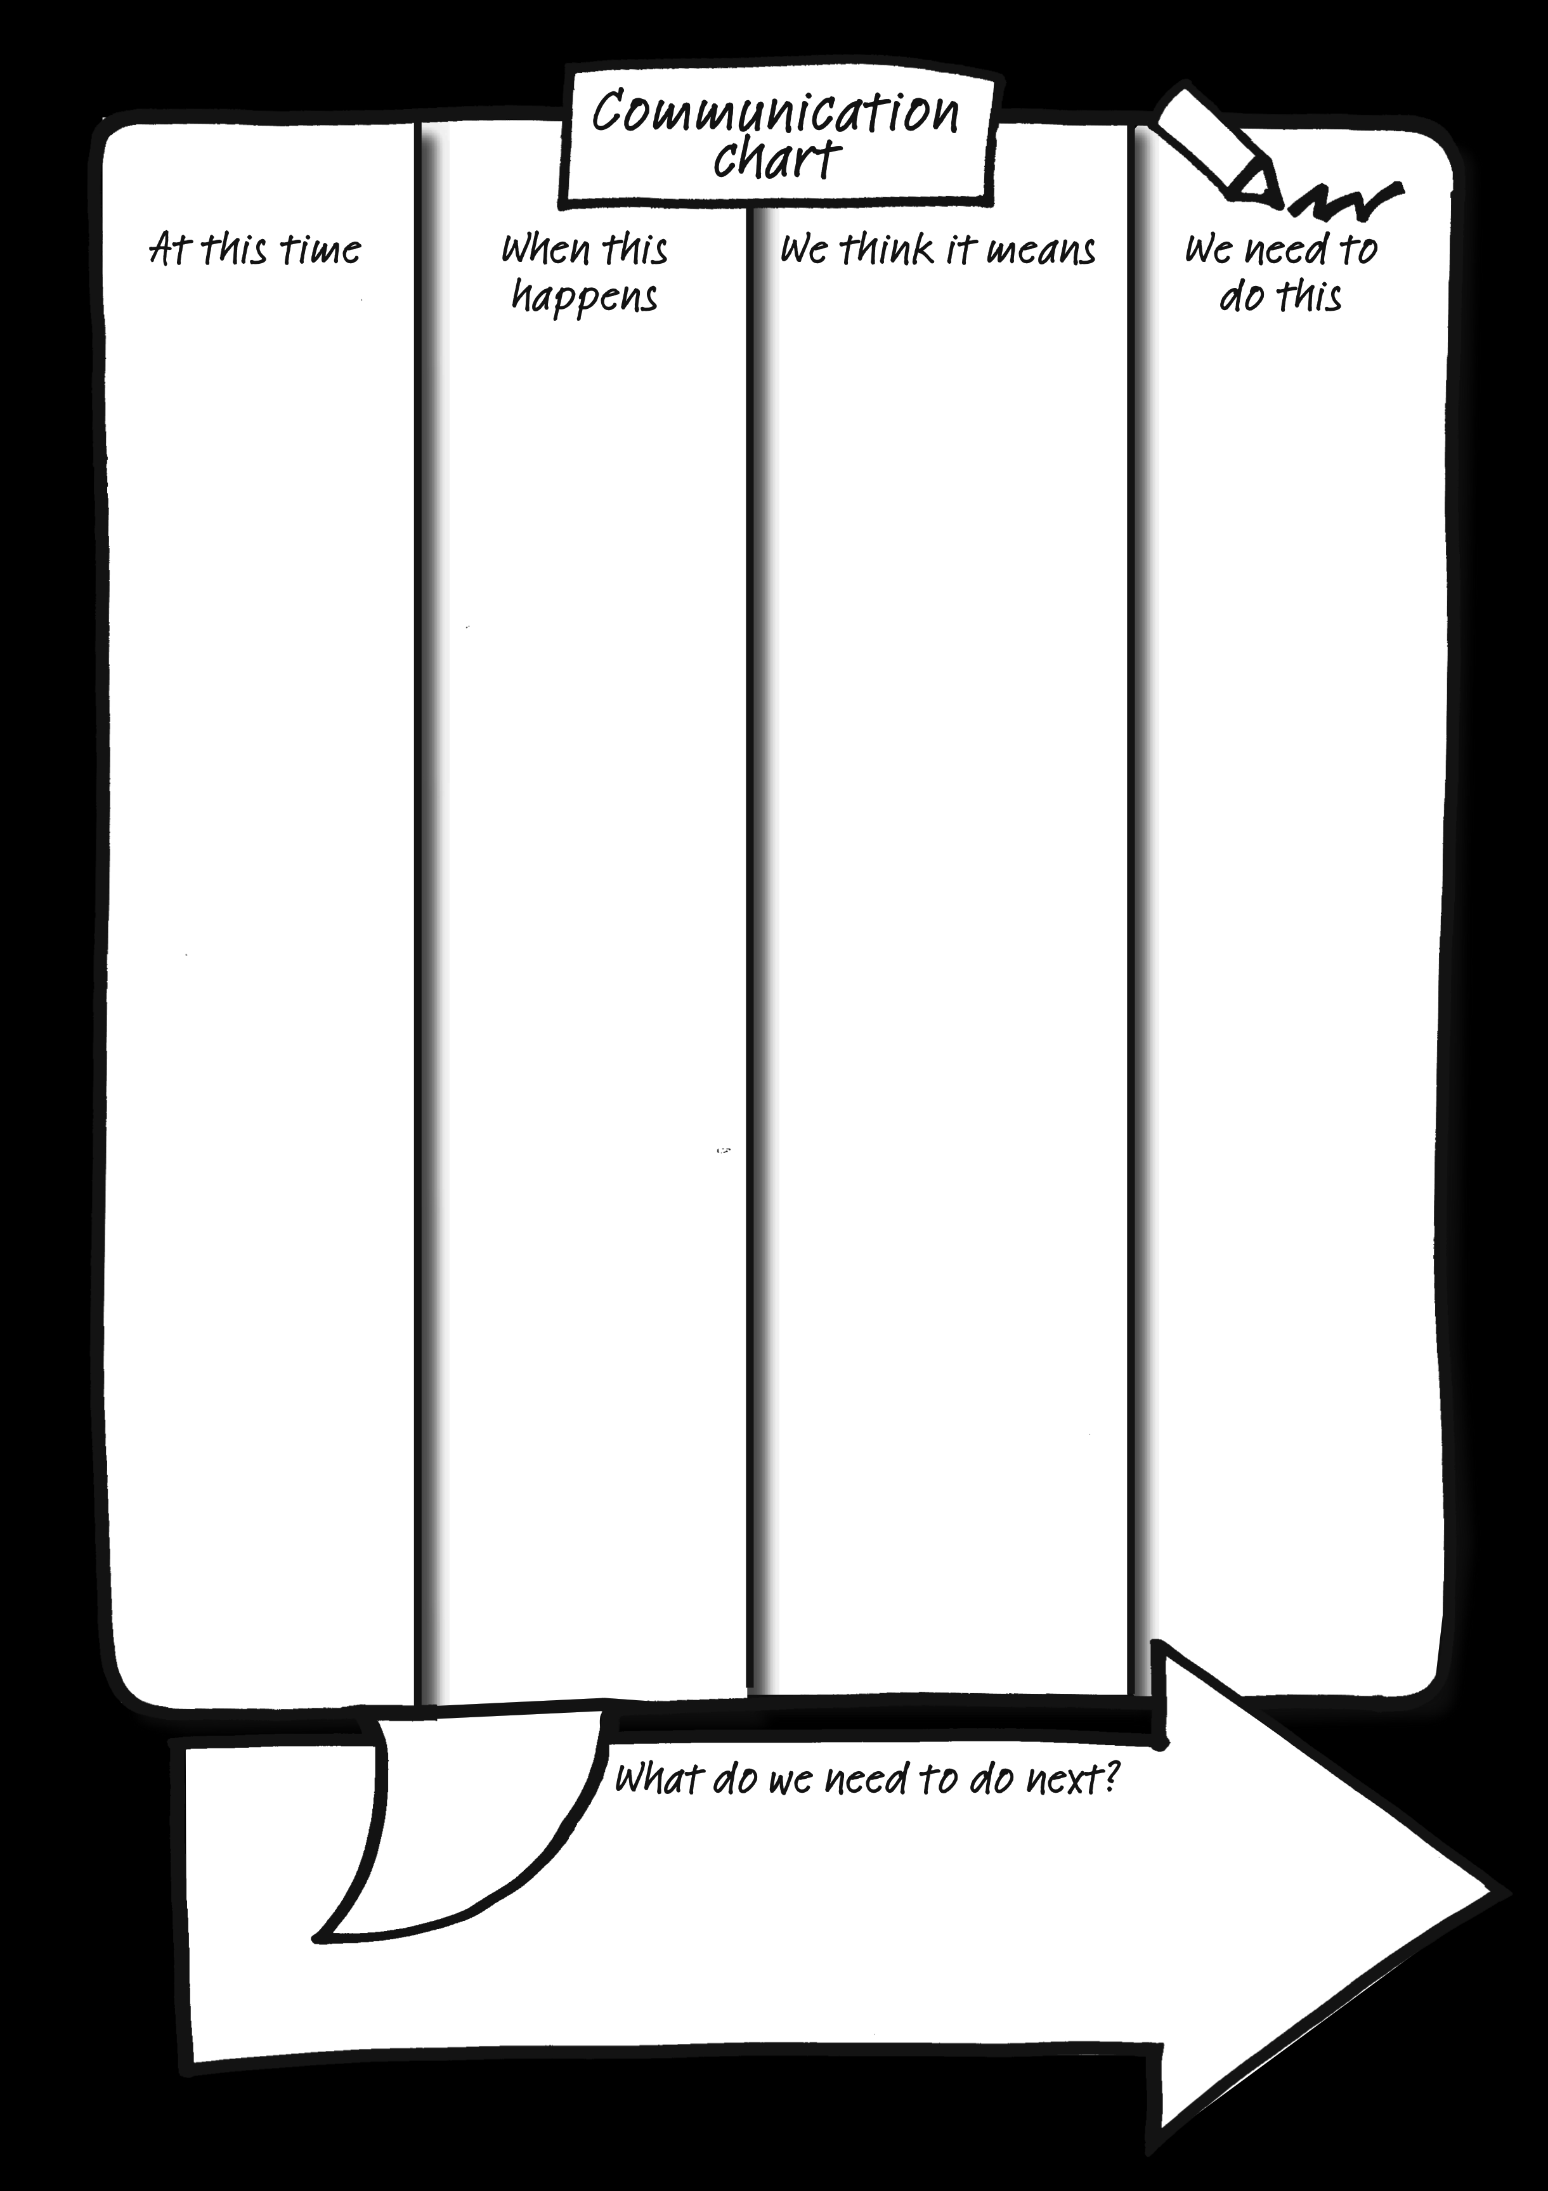
How I communicate
with you

Slide 48
How I communicate with you
Arrives home from college In the environment What’s just gone on The “trigger” | Drops bag to floor, slams door storms upstairs The behavior What others notice Can be seen, heard, and felt by others | She has had a bad day Meaning of the behavior What the emotions and feelings are What’s going on inside | Leave her be she will come and talk when she is ready What other people should do in response Or not do…..
What is happening
Rachel does this
We think it means
And we should
© TLCPCP 2019 www.tlcpcp.com

Slide 49
Steven’s Communication Chart
What is happening… This is going on… | Steven does this… I do this…. | We think it means… It means.. | And we should… I want you to….
Anytime | Approaches you & scratches his chin | He wants to go to the toilet | Support him to the bathroom
Anytime | Sits rubbing his knees | He is bored | Support him to get set up doing his painting or playing cards with Joe is a favourite – check if Joe wants a game.
Anytime | Approaches you & touches your shoes | He wants to go for a walk outdoors | Go for a walk with Steven – He loves all weathers & isn’t put off by rain – walking over Pendle Hill is favourite, but if time is an issue Steven enjoys a walk around the flower beds in the garden
Sitting in the lounge | Steven bangs his cup on the table | He wants company | Sit with Steven, and chat with him. – the soaps are a favorite conversation topic – any of them. Stephen loves every soap on TV!.

Slide 50
Communication Chart For Chuck
What Is Happening | What The Person Does | What It May Mean | What We Should Do
It is Sunday | Calls afterhours and leaves you a voice mail that includes scripture or singing of a gospel song | Chuck had a great day at church! | Do nothing.
Anytime other than Sunday. | Calls and leaves you a lengthy voice mail that sounds like a sermon. | Chuck might be having some mental health issues. He may have forgotten to take a dose of medication. | Call Chuck and ask if he remembered to take his medication, he will likely check and then tell you yes, he forgot. For the next few days, call Chuck in the morning and offer supportive reminders to take his meds.
Anytime | Makes any mention of “Ruby Red Lights”, even just a passing reference. | Chuck is experiencing auditory hallucinations. (Ruby is deceased and by history is one of the “voices” Chuck hears when he is hallucinating) | Drop by and see Chuck. Check his med box. Stick around and chat for awhile (be on the look-out for any signs that he may be experiencing hallucinations or delusions. Contact his Psychiatrist and take recommended next steps. (Schedule an appointment, increase visits to daily, etc.)
Anytime | Stops eating and tells you that his food has been poisoned or that there is blood in his food. | Chuck is experiencing delusions and auditory hallucinations. | This is an EMERGENCY! Call the Mobile Crisis Unit and support Chuck in being assessed for possible admission. Stay with Chuck until they arrive. Offer reassurances that you are there to help keep him safe. Do NOT try and convince him that his food is not poisoned.
Notes:
TLC-PCP www.learningcommunity.us

Slide 51
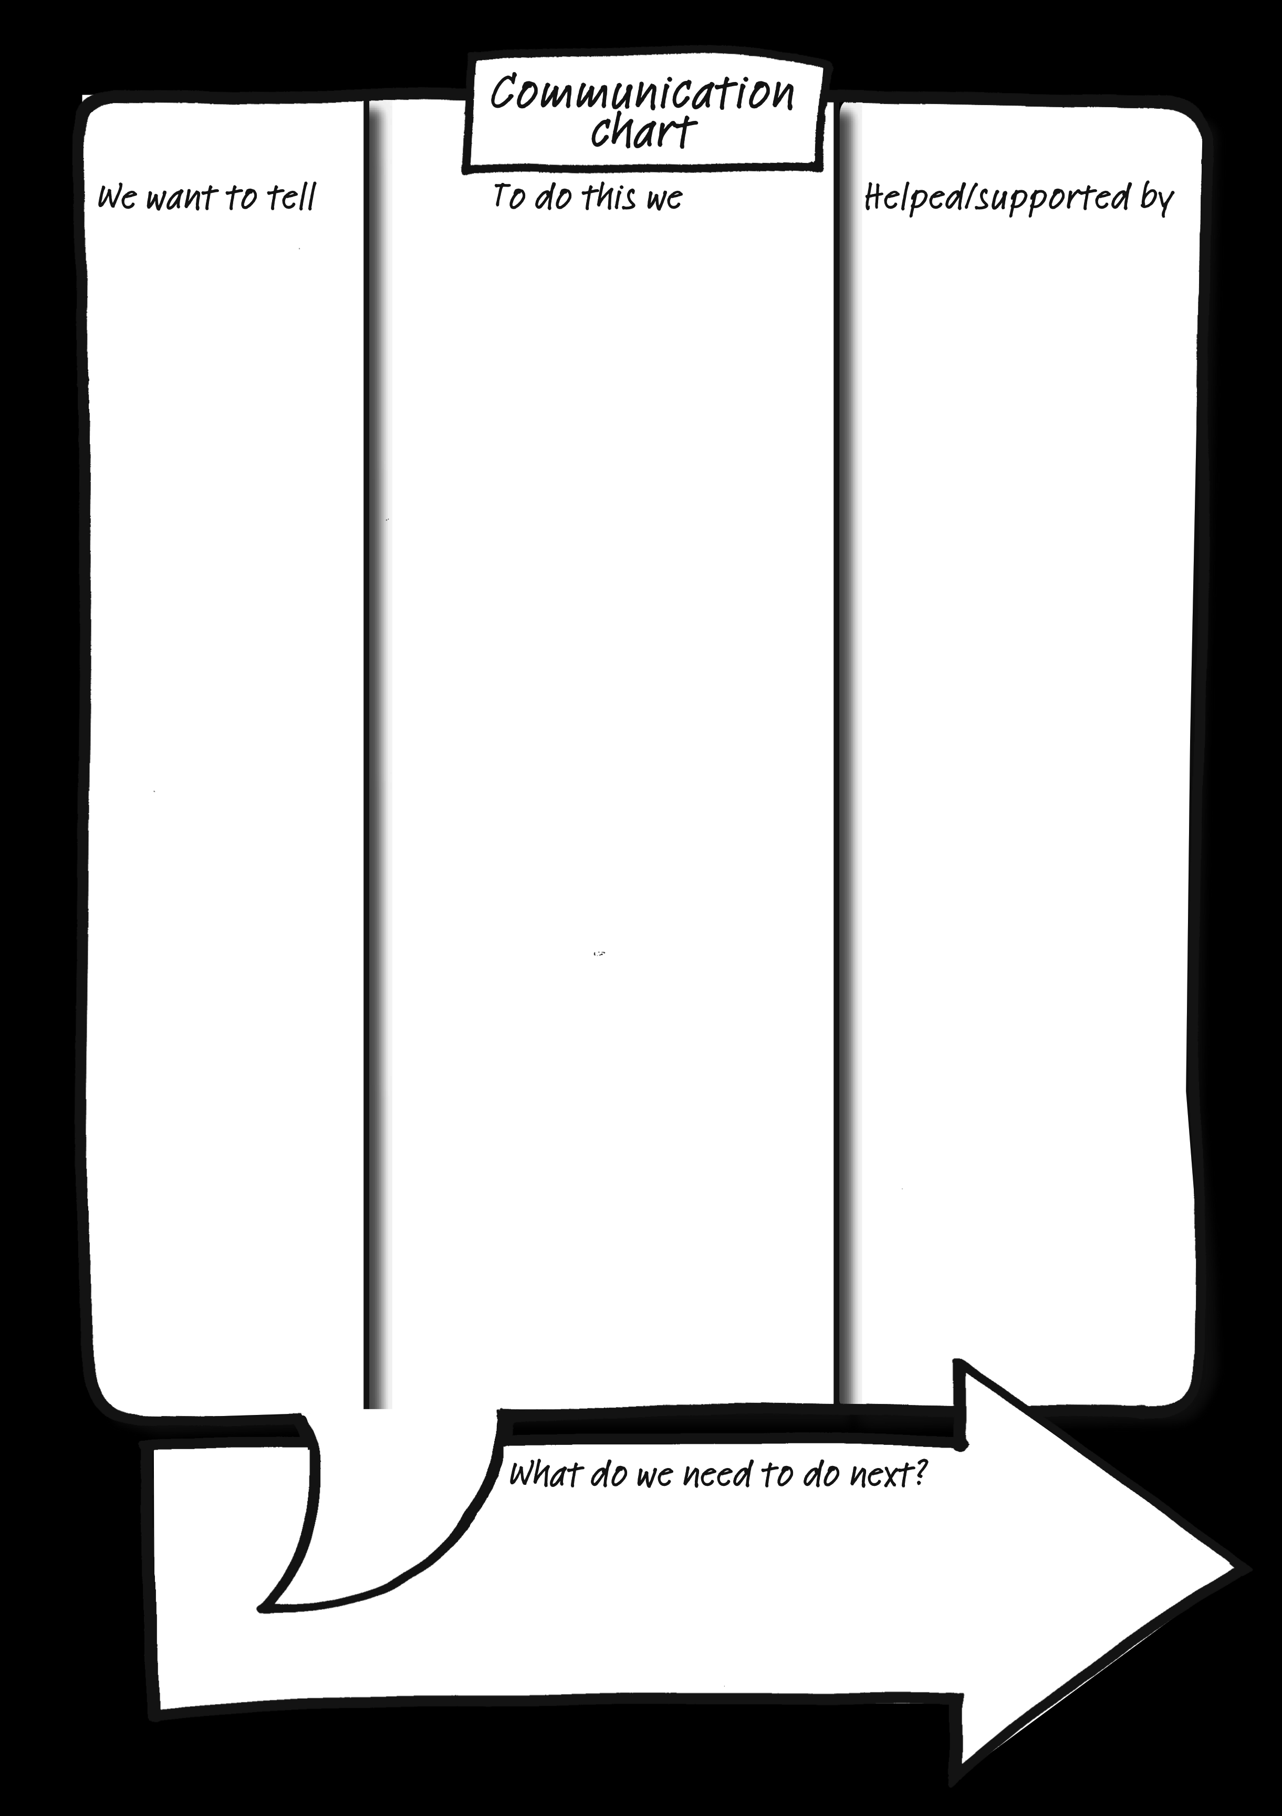
How you
communicate with me

Slide 52
THINGS WE NEED TO COMMUNICATE WITH KYLE
We want to let Kyle know | To do this we | Then support/encourage Kyle to
It’s time to get up (if Kyle is not already awake). | Knock on Kyle’s bedroom door and then open it. | Continue Kyle’s morning routine. See “to be successful”.
It’s time to have a bath. | Run bath while Kyle is in his bedroom and when bath is run open his door. | Kyle will get into the bath unsupported.
It’s time to have a shave. | Show Kyle his razor and shaving cream. | Apply shaving cream and have a shave.
It’s time to have hair washed. | Show Kyle shampoo. | Apply shampoo and have his hair washed.
It’s time to get dressed. | Show Kyle his clothes. | To dressed by letting him know what he needs to do. For example, pointing and tapping his leg to lift, etc.
Breakfast/lunch/dinner is ready. | Show Kyle his meal. Encourage Kyle to go into dining room. | Sit at the table and eat his meal.
It’s time to take medication. | Show Kyle the syringe. | Sip his medication.
It’s time to have teeth cleaned. | Show Kyle his toothbrush. | Come and sit in the kitchen and have his teeth cleaned.
It’s time to go to the toilet. | Show Kyle incontinence pad/leg bags/enema. | Walk to the bathroom by pointing and guiding him by his elbow.
It’s time to go out. | Show Kyle his boots. | Put his boots on and walk to the door.
It’s time to go for a walk. | Guide Kyle past the car to the gate. | Walk at his own pace.
It’s time to go out in the car. | Show Kyle the car keys or rattle the car keys. | Walk to the car.
It’s time to go to the pub. | Show Kyle his pint pot glass. | Support Kyle to go to the pub.
It’s time to buy chocolates. | Show Kyle a chocolate wrapper. | Support Kyle to shop and buy chocolate.

Slide 53
Decision-Making
Types and Processes
Informed decision-making
Supported decision-making
Substitute decision-making
© TLCPCP 2019 www.tlcpcp.com
Notes:
TLC-PCP www.learningcommunity.us

Slide 54
Decision-Making
Spend 5 minutes at your tables sharing a significant decision in your life during the last couple of years:
What was the decision to be made?
How did you consider your options?
How were you involved & did anyone help
you with the decision?
Who made the final decision?

Slide 55
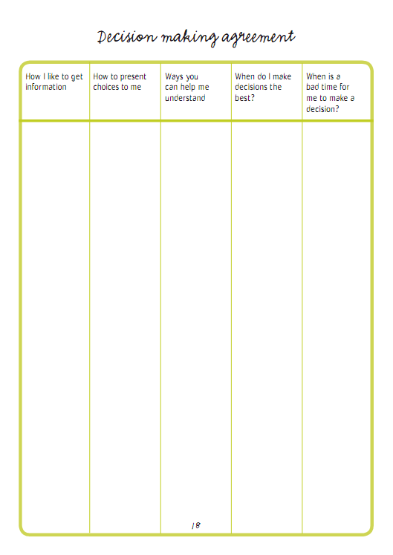
profile

Slide 57
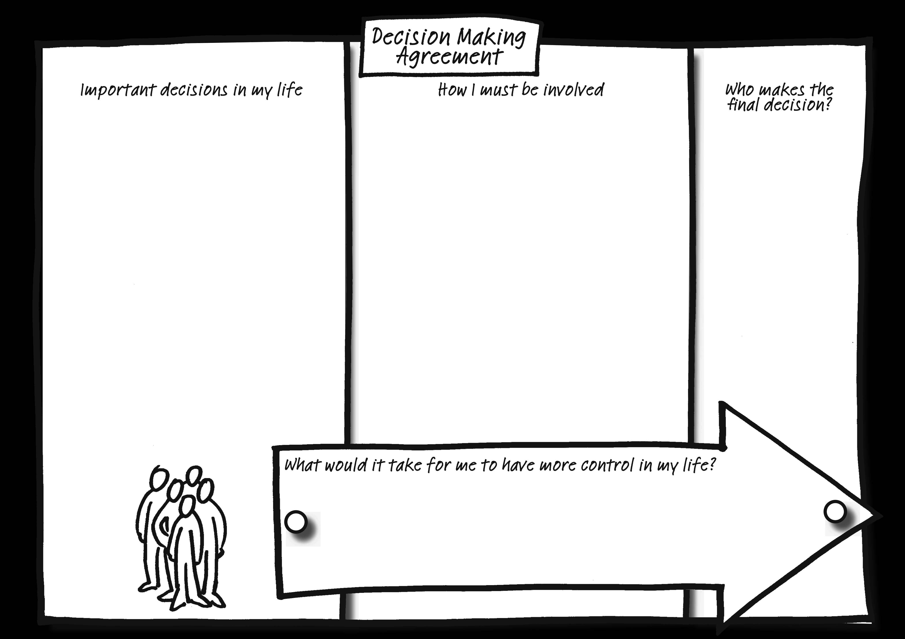

Slide 58
Decision Making Agreement

Slide 59
Decision Making Agreement
Decision to be made | How Gerry must be included | Who makes the final decision
How he spends his money What he eats Where he goes and when How he manages his sleep | Gerry should be consulted and involved in his monthly expenditures and budgeting if he chooses and can decide how to spend his daily money Gerry must participate in his grocery shopping and choose the foods that he wants to buy, his supports are with him and can encourage him to buy a balanced diet Gerry has the freedom to travel the city alone, when there are concerns for his safety supports, mom will discuss and educate and ensure a crisis plan is in place Involve him in all medical appointments and decisions about potential strategies to address insomnia | Mom manages the finances and makes the final decision about how money is managed and how much Gerry gets daily Gerry decides what he will eat Gerry decides where he will go and when Mom and Gerry will decide together which strategies to try

Slide 60
When I have company coming over
  I am not comfortable unless my home is perfectly clean
I am ok with my home whatever the state
What is one other cultural thing you do to prepare your home for company?

Slide 61
When I have guests
I always offer them food and/or drink
I do not offer them food and/or drink
If your guests are there for a meal, do you serve alcohol with the meal?

Slide 62
When guests dine with me in my home
  I expect them to stay for a while after the meal
I expect them to leave as soon as the meal is eaten
What do you do if your guests offer or even insist on helping with dishes and clean-up?

Slide 63

Keep Culture in Mind
Culture is:
  About why you think things are right and wrong, good or bad, how things are supposed to be.
  Is learned and shared knowledge that specific groups use to generate their behavior and interpret their experience of the world. It includes, but is not limited to communication, rituals, and roles.
Culture can be revealed in comments like:
That is not how we do things in our family
That is not right
Nice people don’t do that
Women/men don’t do that
You will embarrass the family
That is against my (our) religion
People with disabilities shouldn’t (cannot) do that
That is not something we talk about
Those providing support should:
Be aware of their own cultural assumptions
Be prepared to express their own point of view in a transparent way when necessary
May need to:
Think about what the other person’s cultural values might be and check with them
Plan how to explain cultural issues--be understood and respected yet flexible
Be prepared to have more than one conversation
Slide Source: © 2014 - Georgetown University Center for Child and Human Development and © 2016 Georgetown University National Center for Cultural Competence

Slide 64
© TLCPCP 2019 www.tlcpcp.com
Notes:
TLC-PCP www.learningcommunity.us

Slide 65
Organizing Discovery Information
Three ways to organize discovery information
Person centred description
Person centred / directed plan
One-page profile
© TLCPCP 2019 www.tlcpcp.com
Notes:
TLC-PCP www.learningcommunity.us

Slide 66
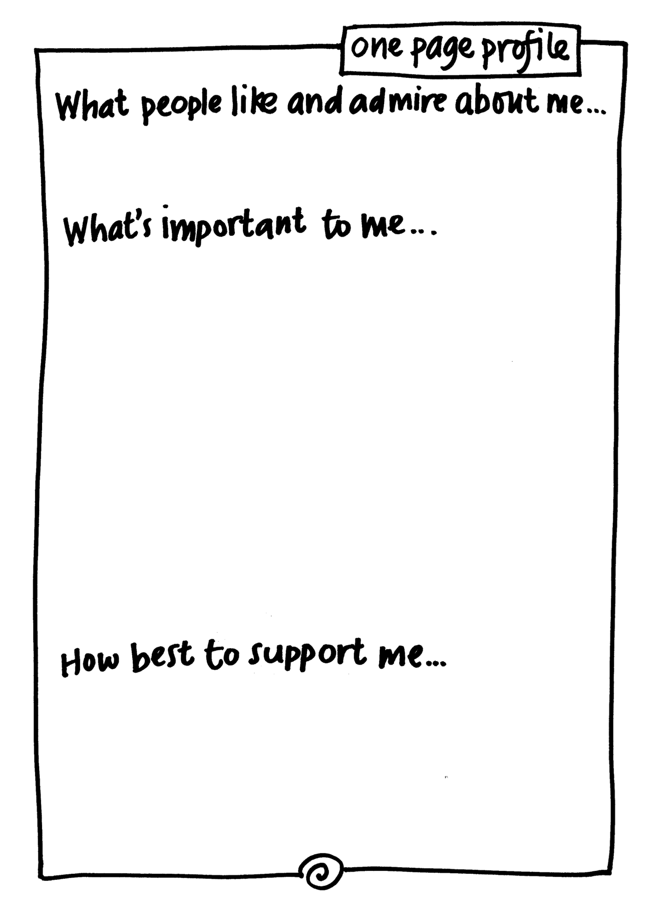

Slide 67
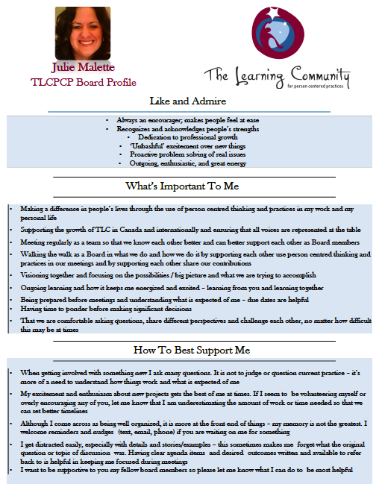

Slide 69

www.hsacanada.ca
www.tlcpcp.com
Barb Swartz-Biscaro
barbs@hsacanada.ca

