Slide 1
Person-Centred Approaches
Session 1

Slide 2
Breakout rooms
Facilitator
Keep things moving
Remind of 1 person at a time
Encourage everyone to participate
Timekeeper
Keep eye on the clock and give people reminders of how much time is left.
When using timed rounds, let people know when their time is about to end
Recorder/Reporter
Keep notes for the group – point form is fine
Report back to larger group – either verbally or in Chat based on request

Slide 3
Each of us want lives where we are
supported by & contribute to our communities
Have our
own dreams and our own journeys
Have opportunities to meet
New people; try new things; change
jobs; change who we live with & where we live
Have what/who is important to us in everyday life; people to be with; things to do, places to be
Stay healthy & safe (on our own terms)
© TLCPCP 2019 www.tlcpcp.com

Slide 4
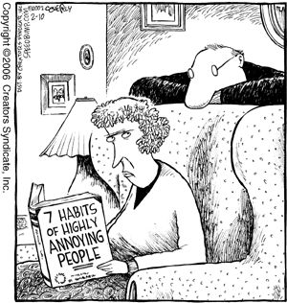
What grates on your last nerves?
© TLCPCP 2019 www.tlcpcp.com

Slide 5
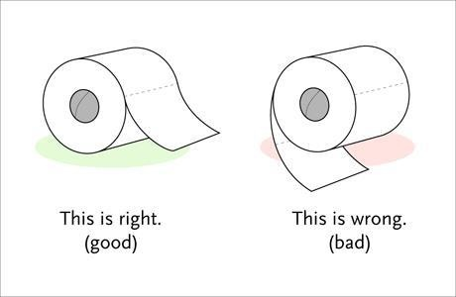

Slide 6
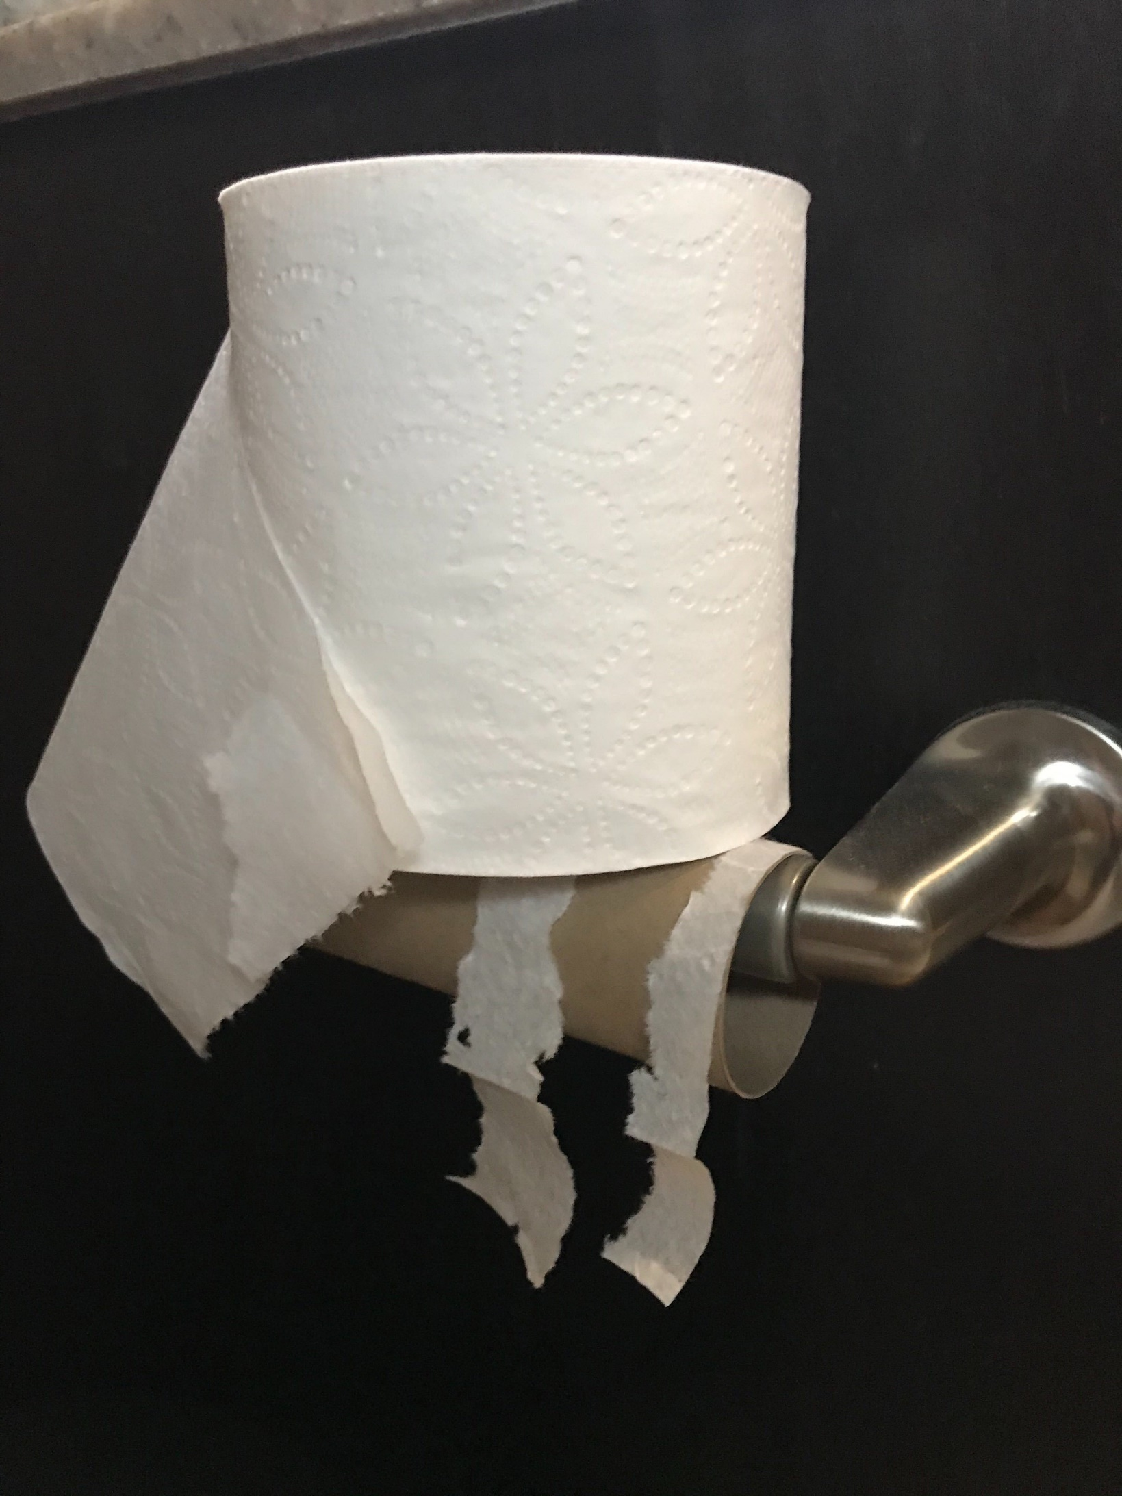

Slide 7
Things that people do at home
that gets on your last nerve

Slide 8
How do you react? What do you do?

Slide 9
1 year later
same situation plus a system response
How do you feel now and what do you do?

Slide 10
5 years later
person-centred planning
No change
How do you feel and what do you do?

Slide 11
What would it take to trust?

Slide 12
Person-centred planning or using person-centred thinking tools is a set of promises
To listen
To act on what we hear
To be honest
© TLCPCP 2019 www.tlcpcp.com

Slide 13
”
Help people get better lives…
…not just better paper
“
© TLCPCP 2019 www.tlcpcp.com

Slide 14
Importance Of Environments
Toxic
Tolerated
Healing
Supportive
Causes significant aggression or depression.
What is toxic to one person may not be toxic to someone else
Results in Power Over as we try and control the aggression or withdrawal
People are depressed, have given up.
We see “learned helplessness”
May have been toxic but people feel powerless
There is no (or very little) growth
Power Over
In a supportive setting there is growth.
People have moved from toxic or tolerated “blossom.”
There is Power With
This is the minimum for everyone.
Needed for some people wounded by toxic or tolerated settings
Focus is on restoration and wellness. There is a need to partner with clinical supports
Power With
© TLCPCP 2019 www.tlcpcp.com

Slide 15
“
Person-centred thinking and planning is a process of continual listening and learning, focusing on what is important
to someone now and in the future and acting upon this in alliance with their family and friends.
Michael Smull
”

Slide 16
Introducing the Core Concept:
important to
and
important for
AND
The balance between them
© TLCPCP 2019 www.tlcpcp.com

Slide 17
Important TO
What is important to a person includes those things in life which help us to be satisfied, content, comforted, fulfilled, and happy. It includes:
People to be with /relationships
Status and control
Things to do and places to go
Rituals or routines
Rhythm or pace of life
Things to have
© TLCPCP 2019 www.tlcpcp.com

Slide 19
“Nacho naps in my fanny pack until 12 noon every day”

Slide 20
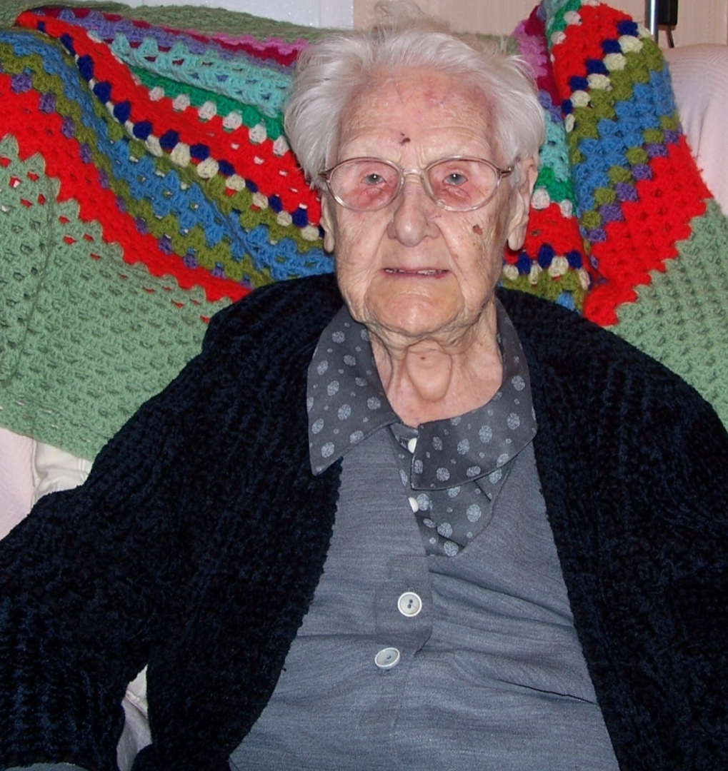
‘ I might be 104 but I enjoy my nip of whisky in my tea and a wagon wheel for supper, it’s gorgeous.’

Slide 21
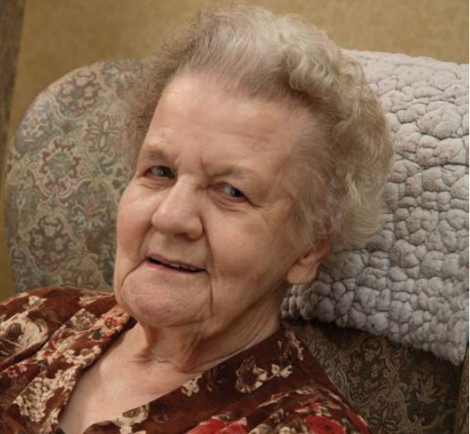
‘It’s awful when you are in bed & you don’t know what time it is. The night seems to go on forever’

Slide 22
Important FOR Part One
Issues of health:
Prevention of illness
Treatment of illness / medical conditions
Promotion of wellness (e.g.: diet, exercise)
Issues of safety:
Environment
Well being ---- physical and emotional
Free from fear
© TLCPCP 2019 www.tlcpcp.com

Slide 23
Important FOR (Part Two
What others see as necessary to help the person:
Be valued
Be a contributing member of their community
© TLCPCP 2019 www.tlcpcp.com

Slide 24
all choice no responsibility
to

Slide 25
All choice: No responsibility

Slide 26
Health and safety can dictate
for

Slide 27
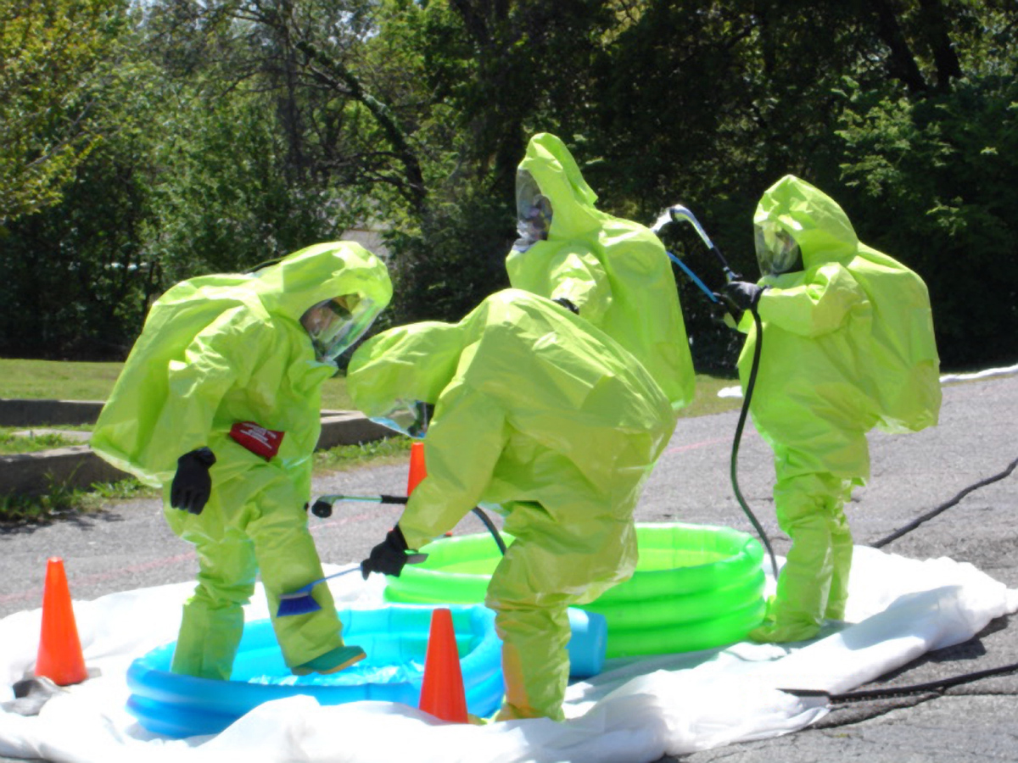
Health and Safety can dictate life

