Slide 1

Person-Centred Approaches
Session 4
Person-Centred Approaches
Day two

Slide 2
Practical application
Communication charts
Create a communication chart with someone you support – choose the most appropriate chart for the situation
Decision Making tools
Use the decision-making profile or agreement with someone you support – what did you learn?
Relationship Circles and Maps
Use the relationship circle or map with someone you support – what did you learn?

Slide 3
”
Help people get better lives…
…not just better paper
“
© TLCPCP 2019 www.tlcpcp.com

Slide 4
Learning about Support
Power Over
Power With
Supporting vs Fixing
© TLCPCP 2019 www.tlcpcp.com
Notes:
TLC-PCP www.learningcommunity.us

Slide 5

Supporting vs Fixing

Slide 6
7 Questions you should be able to Answer for each Person you Support
What is important to the person?
What is important for the person?
Is the connection between important to and for addressed?
Is there a “good” balance between important to and important for?
What does the person want to learn, what do we need to learn?
If the person is to get the balance described and we are to learn:
What needs to stay the same (be maintained or enhanced)?
What needs to change?
© TLCPCP 2019 www.tlcpcp.com

Slide 7
Facilitation skills are needed to…
Have meaningful conversations
Ensure that the person we plan with remains in charge as we learn
© TLCPCP 2019 www.tlcpcp.com
Notes:
TLC-PCP www.learningcommunity.us

Slide 8
Two ways to have a conversation…
Linear
Branching
© TLCPCP 2019 www.tlcpcp.com

Slide 9
Being mindful of Question Types that
will limit what you learn
Close ended questions that lead to yes/no answers
-Do you like shopping?
-Is watching television important to you?
Leading questions with built-in answers
-You like going shopping don’t you? (while nodding your
head yes)
-Jane is your friend isn’t she?

Slide 10
Questions that help us learn more
of what we need to know
So tell me more about that…
What do you like about…
What is it about this…
What is happening for you then?
Are some mornings better than others? What makes them better?
© TLCPCP 2019 www.tlcpcp.com
Notes:
TLC-PCP www.learningcommunity.us

Slide 11

Having a conversation

Slide 12
Our Mantra for the Exercises
Guess: look at what your partner wrote and guess in your head
Ask: ask your partner if your guess is correct, have a conversation, not an interview!
Check: how would your partner phrase it, in their words?
Write: write down what you learn

Slide 13
Building a One Page Profile
Core Elements
What People
Like and
Admire about
the person
One Page
Profile

Slide 14

http://www.youtube.com/watch?v=MiLJucWsbgk

Slide 15

Reputation
Exercise

Slide 16
Reputation Exercise – Part 1
Divide a sheet of paper in half and write ‘Positive Reputation’ on the top-left side and ‘Negative Reputation’ on the top-right.
NEGATIVE REPUTATION
POSITIVE REPUTATION
  Write down 3 mild negatives, for example:
  Stubborn
  Directionally impaired
  Workaholic
© TLCPCP 2019 www.tlcpcp.com

Slide 17
Reputation Exercise – Part 2
For each negative, ask 3 questions:
Are there circumstances in which the negative is a positive?
If yes, add the like and admire (appreciation) section of the one-page profile.
Does the negative reflect something that is important to the person?
If yes, add it to the important to section of the one-page profile.
Is the negative sometimes a problem, If yes, what do other people need to know or do to support the person when it is a negative?
Add it to the how to best support section of the one-page profile.
© TLCPCP 2019 www.tlcpcp.com

Slide 18
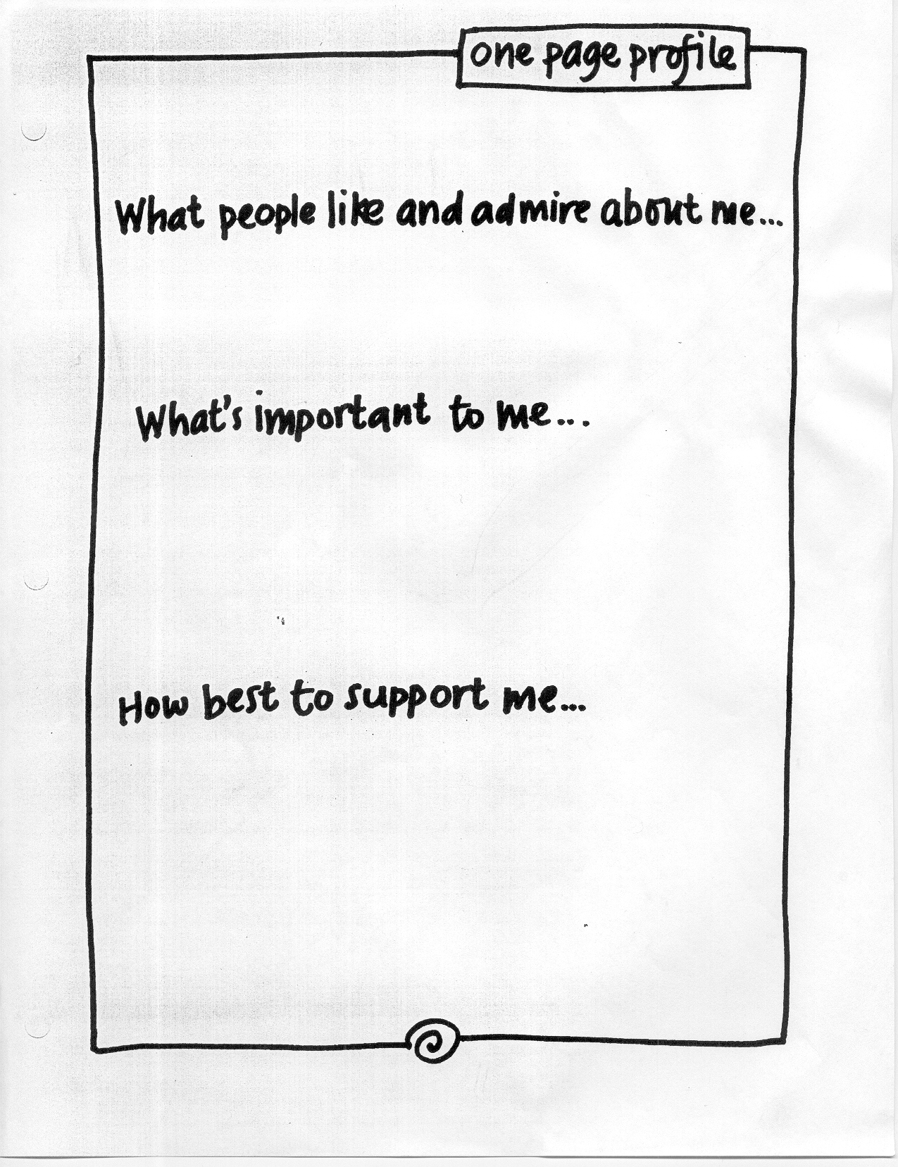
Is she stubborn or is it
something else?
Is the negative sometimes a positive for this person? i.e. is
the person sometimes simply
determined or showing perseverance?
Determined
I like doing things my way unless you can help me see the value in doing it differently.
it tell us something about what is important to her? i.e. What is she stubborn about? Does
When I’m tired, I’m sometimes
stubborn for no reason at all. Suggest that we can do the activity or have the conversation later.
Is she sometimes just being plain
old stubborn? If so, does she want support with this and what does that look like?

Slide 19
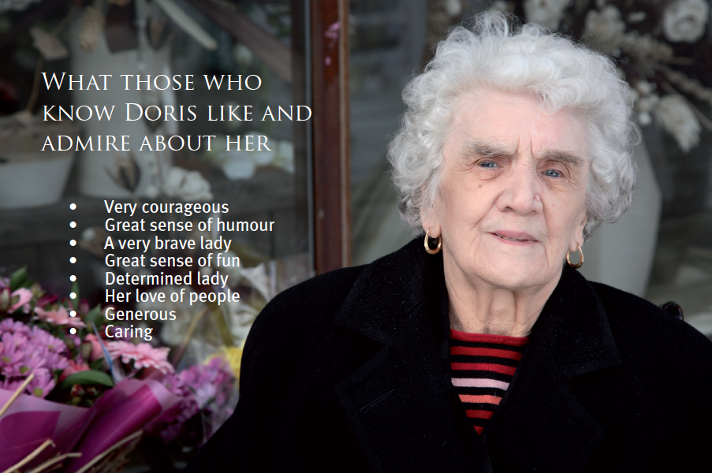

Slide 20
Use of Language
‘If thought can corrupt language , then language can corrupt thought.’
- George Orwell
a story…

Slide 21
Building a One Page Profile
Core Elements
One Page
Profile
Important To
the person
How to best
support
the person

Slide 22
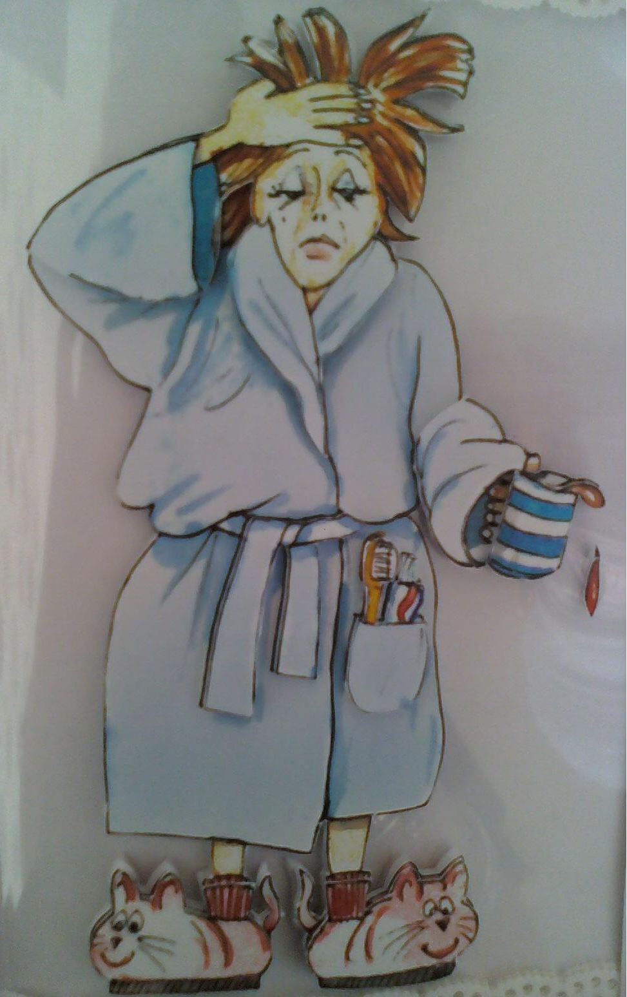

Morning Ritual

Slide 23
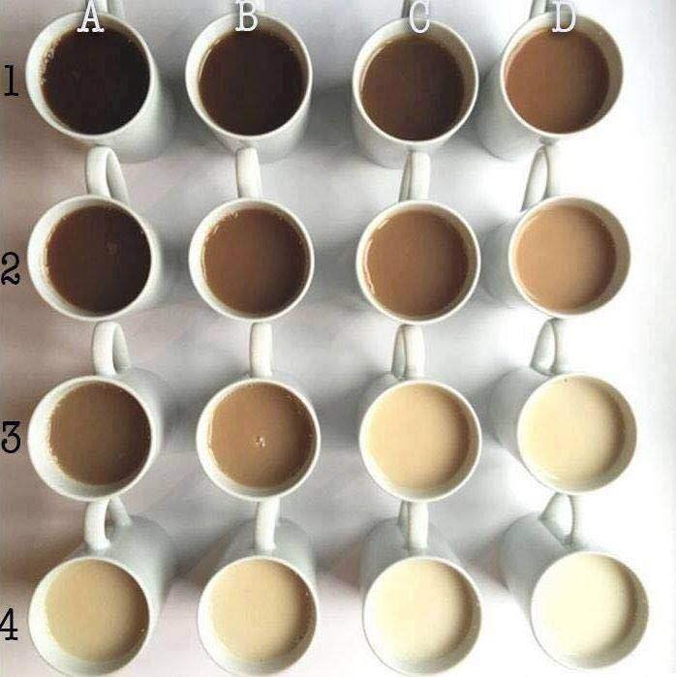

Slide 24
Barb’s Morning Routine
5:30 am Mike gets up, turns on the tv, goes to the shower and makes coffee
5:45 am Mike comes back to bed with a coffee for each of us and watches Mayday while I snooze (he shakes me and reminds me coffee is beside my bed)
6:00 am Get another reminder that my coffee is getting cold
6: 30 am he gets another coffee and warms mine up – yet another reminder
7:00 am I wake up and watch half an hour of tv (news and weather on CBC) with Mike and drink my twice warmed coffee
7:30 am Get out of bed, say good morning to the dog, go to kitchen table to have another coffee and check my emails, social media
8:00 am If it’s nice out I put my walking clothes and Fitbit on, Mike and I go for a walk, if no walk is happening, I go straight to the shower
9:00 am Get back from our walk and have a shower; Affinia shampoo and conditioner, Deep Marine face wash, Platinum bath bar, shave underarms everyday, legs every other day
9:10 am Get out of shower, use fluffy soft towel, brush hair, put on deodorant (Sheer Confidence powder), put on deep marine day time face cream, take Vitamin D drops and vitamins
9:15 am go to my room and get dressed, if I have no meetings I dress in tights and t-shirts, if I have meetings, I dress in work clothes
9:20 am go back upstairs, put hair mousse in, put makeup on, brush teeth (sensitivity tooth polish) dry hair and flat iron, make some toast or grab an orange
9:30 am go to my office with a glass of water with orange EO drops in it, start my diffuser, smudge, (if I have time before meetings, I do ½ hr Reiki self treatment), start my workday

Slide 25
Rituals – Part 1
Write down your morning ritual
Include as much detail as you are comfortable with
Tell us how long it takes – indicate what time it starts and what time it ends
© TLCPCP 2019 www.tlcpcp.com
Notes:
This training focuses on how to gather information and how to use that to develop a 1st plan. Because this training skips the first step you need to help people notice what should happen. Emphasize that plans that work are always developed in partnership and that they always start with thinking about what you want to learn. The next slide has some of the questions that those who write plans should start with

Slide 26
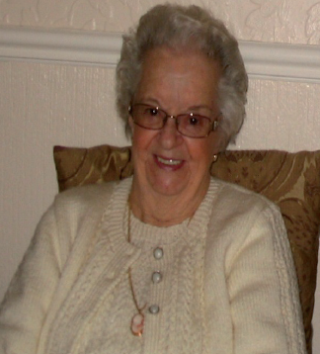
It was important to Joan to be able to stay in bed for 30 minutes after being woken in the morning so as she could say her prayers, we discovered that what wasn’t working for her was that this only happened when the staff who knew her well were on duty.

Slide 27
Other Rituals
Going to bed
Mealtimes
Transition
Birthday
Cultural/Holiday
Spiritual
Vacation
Comfort/health
Celebration
Mourning/grief/loss
© TLCPCP 2019 www.tlcpcp.com

Slide 28
Add to your one-page profile
Work rituals that are important
to you
How you want/need to be supported by co-workers

Slide 29

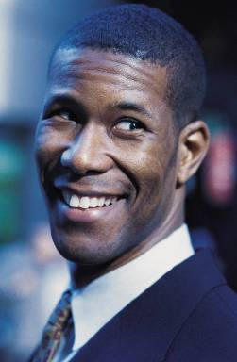

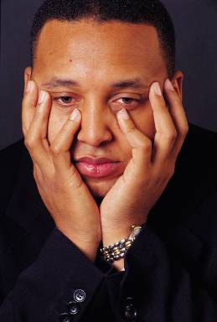


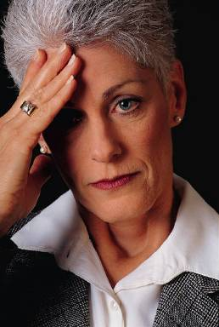






Good Day
Bad Day
© TLCPCP 2019 www.tlcpcp.com

Slide 30
At work
It is a work day, start with getting up, end with going to bed. Write down a composite of all the good moments you have had on a work day and all of the bad moments.

Slide 31
What happened that contributed to your good day?
What do you look forward to doing?
Who do you look forward to seeing?
What happens that gives you energy to deal with difficult situations?
What motivates and interests you at work OR on a work day?
What threw your day off?
Made the day bad for you?
Made you frustrated? Bored?
Took the fun out of it?
Be sure to include those daily frustrations

Slide 32
Your Good Day/Bad Day
Time Of Day | Typical | Better | Worse
Morning at home
Commute
Morning at work
Lunch
Afternoon at work
Commute
Evening
Overnight
© TLCPCP 2019 www.tlcpcp.com

Slide 33
Time Of Day | Typical | Better | Worse
Morning at home | Get up at 7:30 Have 2 cups of coffee before shower Go for a walk Let the chickens out, gather the eggs Do self reiki treatment, Skip breakfast | Sleep until 8 Breakfast is made for me so I actually eat | Don’t have time for a walk or Reiki Get woken up before 7:30 In a rush and don’t get my two cups of coffee Don’t eat until lunch If someone does the chickens for me
Commute | Drive to meetings tired or in auto pilot | Stay mindful as I drive and appreciate my surroundings | Winter drives or rainy days that make the drive gloomy
Morning at work | Get diffuser running Put music on Check email and social media messages Get started on a project or to do list | Email box is empty There is nobody around so I can focus My desk is clean and I am caught up from the day before | There are a lot of email to address before I can get to my to do list Unexpected projects or demands come up Computer needs to update Not connecting with co-workers or team mates
Lunch | Grab a salad and eat at my desk | Have time to take a break and eat at the table or outside and wander through my gardens | Eat a “quick fix” like a sandwich or junk food
Afternoon at work | Continue with to do list or meetings | Have a nap or time for a walk Able to stop working early | No time for a break or work past 4 pm
Commute | Drive tired or in auto pilot | Be mindful and appreciate the beauty around me | Drive in rain or snow or lots of traffic
Evening | Watch the Young and the Restless at 4:30 with a glass of wine Make dinner at 5:30 Watch the news and CSI or Dragons Den with my husband Go to bed by 9 | When the kids are home for dinner with us When the kids sit with us to watch tv Have time outside to relax or go for a walk in the bush or wander my gardens | Having meetings between 4:30-6:30 Missing my show No wine Its rainy or cold and not good weather to get outside
Overnight | Sleep at 9 pm until 7:00 am Wake for drinks of water or my husband is restless or watching tv | If I don’t wake at all through the night | If I have to go to the bathroom in the night When my husband wakes me to talk because he can’t sleep or wants me to have a coffee with him at 5 am

Slide 34
Work with your partner. Ask questions to discover Typical/Better/Worse for 1 part of the day.
Time Of Day | Typical | Better | Worse
Morning at home
Commute
Morning at work
Lunch
Afternoon at work
Commute
Evening
Overnight
© TLCPCP 2019 www.tlcpcp.com

Slide 35
Using your partner work…
Time Of Day | Typical | Better | Worse
Morning at home
Commute
Morning at work
Lunch
Afternoon at work
Commute
Evening
Overnight
?
add to the what is important to section. As you add each item, ask “Is there something that other people need to know or do to support me with this?” If there is, add to the How best to support me section.

Slide 36
good day / bad day:
Not connecting with co-workers or team mates
Important to me:
How best to support me:

Slide 37

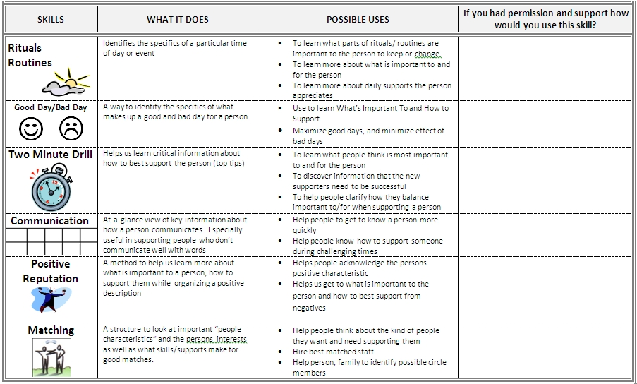
Take your important to/for you information and your 2 minute drill information and add it to your one-page profile

Slide 38
Practical application
Reputation
If someone you support or a colleague has a negative reputation, think through the 3 questions and see if this provides insight and understanding.
Rituals and routines
Would this be helpful for someone you support? Which part of the day would a detailed written ritual/routine be helpful for?
Good Day / Bad Day
Use this to gather information about what can help the person have better days and to address what is making the person have bad days. Address the issues.
Add ideas to your Action Plan in your workbook
Feedback on Slack
Notes:
Activity – 8 minutes total (about 1 minutes each for introductions)
introduce themselves
1 thing they are passionate about (hobby, interest)
choose roles for activities today

