Slide 1
Learning personality ‘characteristics’ that
need to be Present or Absent in supporters
To learn the characteristics that need to be present, ask: | To learn the characteristics that need to be absent, ask:
Who is closest to the person? Who enjoys spending time with the person? Who helps make good days happen for the person? What characteristics do these people have in common? | Who does the person avoid? Who dislikes spending time with the person? Who makes the person have bad days? What characteristics to these people have in common?
© TLCPCP 2019 www.tlcpcp.com

Slide 3
Matching Staff Supporting: Alan
Support wanted and needed | Skill needed | Personality Characteristics Needed | Shared Common interests (would be nice to have)
Able to get out of the Oldham area e.g. Blackpool, Southport | Full driving license Able to go on motorways To be a car driver | Patience/ Confident | They enjoy visiting places and travel
Someone who will take Alan fishing | Someone who can fish Can handle bait maggots worms | Someone who enjoys peace and quiet Someone who is patient Prepared to sit in the rain Not squeamish | Fishing Angling interest
Someone who can use computers | Basic IT Skills Able to problem solve | Able to share computer knowledge Willingness to learn | Enjoys going on the computer
Someone who enjoys going for a meal | Able to engage with Alan where he wants to go. Enjoys socializing | Someone who likes to go out and about Good communicator | Someone who enjoys a nice meal in a pub/restaurant/cafe

Slide 5
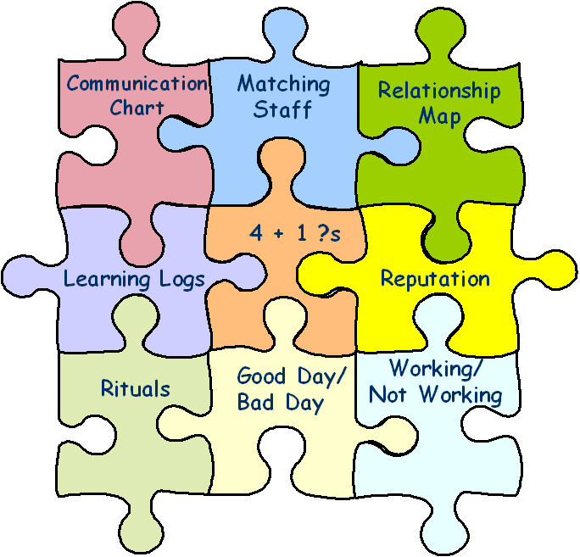
Learning Wheel
What needs to stay the same?
What needs to change?
WW / WNW
Person-Centred
Description
Action
Planning
PCT Tools
Implementation
& Learning
© TLCPCP 2019 www.tlcpcp.com

Slide 6
4 + 1
What have you tried? 1 | What have you learned? 2 | What are you pleased about? 3 | What are you concerned about? 4
What did you do? When did you do it? Who else was there? | What did you learn from your efforts? | What did you like about what you tried? What went well? What worked for you? | What challenges did you encounter? What didn’t you like about what you tried? What didn’t work for you?
+1 – Given your learning what will you do next?
?
?
© TLCPCP 2019 www.tlcpcp.com

Slide 7
What we have done to address Liz’s malnourishment
What have we TRIED? | What have we LEARNED? | What are we PLEASED ABOUT? | What are we CONCERNED ABOUT?
● Healthy frozen meals  Daughter cooking a week’s worth of food for her  High protein shakes 2x a day | She doesn’t like processed food Will almost always eat daughter’s home cooked food Protein shakes work really well  If she is having a really bad day, might only drink one shake at best | ● She is steadily gaining weight  Found at least two options that work for her  She is committed to eating when she can | Stress on daughter to cook and drive 5 hours round trip every weekend Only eating once a day Will lose appetite again if depression comes back
+1: Keep doing protein shakes; find someone local to cook occasionally; keep asking “what did you eat today, not just “did you eat today?”
© TLCPCP 2019 www.tlcpcp.com

Slide 8
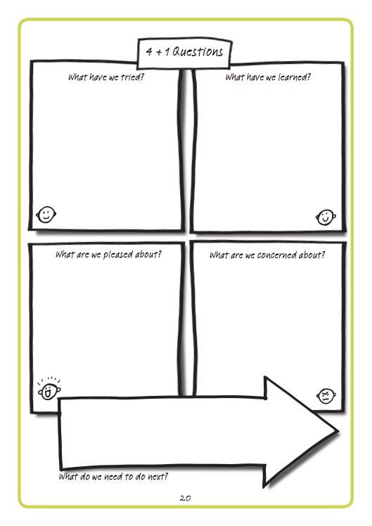

Slide 9
4 + 1
During our time together these last 5 sessions …
?
?
What have you tried? 1 | What have you learned? 2 | What are you pleased about? 3 | What are you concerned about? 4
+1 – Given your learning what will you do next?
© TLCPCP 2019 www.tlcpcp.com

Slide 10
Practical application
Working/Not Working
use this to evaluate a current situation with someone you support, create action around what needs to stay the same and what needs to change
Learning Log
Create a learning log to use for learning around a specific activity or for daily logs
Matching
How can you use this tool to explore the supports someone wants and who the best match would be?
Add ideas to your Action Plan in your workbook
Feedback on Slack

