Slide 1
Person-Centred Approaches
Session 5
Person-Centred Approaches
Day two

Slide 2
Practical application
Reputation
If someone you support or a colleague has a negative reputation, think through the 3 questions and see if this provides insight and understanding.
Rituals and routines
Would this be helpful for someone you support? Which part of the day would a detailed written ritual/routine be helpful for?
Good Day / Bad Day
Use this to gather information about what can help the person have better days and to address what is making the person have bad days. Address the issues.
Notes:
Activity – 8 minutes total (about 1 minutes each for introductions)
introduce themselves
1 thing they are passionate about (hobby, interest) choose roles for activities today

Slide 3
”
Help people get better lives…
…not just better paper
“
© TLCPCP 2019 www.tlcpcp.com

Slide 4
© TLCPCP 2019 www.tlcpcp.com

Slide 5
What makes sense or does not make sense about you bringing home a puppy right now.
 | What works/makes sense | What doesn’t work/doesn’t make sense
Perspective of new puppy owner
© TLCPCP 2019 www.tlcpcp.com

Slide 6
Used to organize perspectives
about a specific issue or
to get a snapshot description of NOW
What’s Working | What’s Not Working/What Could Improve
What does the person say is working? | What does the person say is not working or could be better?
What does the family say is working? | What does the family say is not working or could be better?
What does the staff person/teacher/therapist (etc) say is working? | What do they say is not working or could be better?
© TLCPCP 2019 www.tlcpcp.com

Slide 7
Video
What is and is not working from different perspectives:
Brandon
Mother
Father
Coach

Slide 8
Garth Brooks Video

Slide 9
Garth Brooks video
 | What is working | What is not working
Brandon
Mother
Father
Coach

Slide 10
Working/Not Working
things to keep in mind
Reflect current reality
What is working now, not what would or could work
Focus on a specific issue or area of life
Peel the onion
Always ask the question behind the question
Dig deeper to find more meaningful information
© TLCPCP 2019 www.tlcpcp.com

Slide 11
Working/Not Working
how to use it
Negotiation tool
All must feel listened to – accurately reflect perspectives
Start by focusing on common ground
Remain unconditionally constructive
It is done in partnership
Bridge to action planning
What needs to be maintained/enhanced?
What needs to change?
© TLCPCP 2019 www.tlcpcp.com

Slide 12
 | What works/makes sense | What doesn’t work/make sense
USE THIS INFORMATION TO BUILD THE
A G E N D A
FOR THINGS THAT ARE TO STAY THE SAME
Person’s
perspective
USE THIS INFORMATION TO BUILD THE
A G E N D A
FOR THINGS THAT NEED TO CHANGE
Disagreements
Staff’s
perspective
© TLCPCP 2019 www.tlcpcp.com

Slide 13
Given the medication that someone is taking…Ritalin
 | What’s working | What’s not working
Person’s Perspective | Able to listen and focus Able to think clearly Don’t lose my stuff People don’t get angry with me | Hurts my stomach My mouth is always dry I’m hungry a lot more Classmates know I take medications
Mom’s Perspective | More organized, stuff isn’t scattered She can sit still for periods of time She listens and engages easily More relaxed, less intense No more complaining teacher calls | She is losing weight Complains of her stomach hurting Doesn’t want to take medications Hell hours 4-8:00 pm…she is coming off medication Public school pill !!!!
Teacher’s Perspective | More prepared for school She doesn’t drift off in class Not as emotionally volatile Pays attention to class work Gets along better with classmates | Complains of stomach hurting Always asking for water Sleepy in class Class interruption (to go to nurse for medications)
© TLCPCP 2019 www.tlcpcp.com

Slide 14
Evaluating the work you are doing…
 | What works | What doesn’t work
Perspective of Person Supported
Your
perspective
Supervisor’s
perspective
© TLCPCP 2019 www.tlcpcp.com

Slide 15
person
family
Home supports
Employment
supports
Actions to keep the same
Actions for things to change

Slide 16
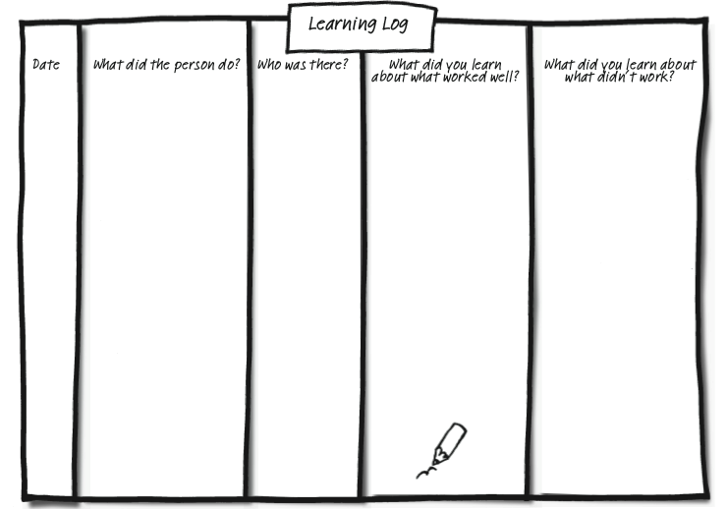
Capturing learning - Learning Log
© TLCPCP 2019 www.tlcpcp.com

Slide 17
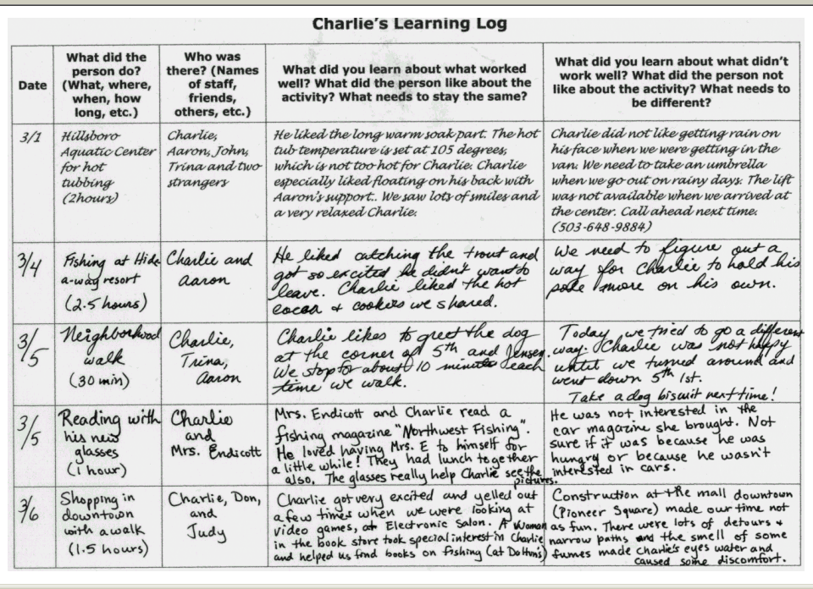
© TLCPCP 2019 www.tlcpcp.com

Slide 18
Charlie’s One-Page Profile for Support Staff
What others like and admire about Charlie
What is Important to Charlie
How Best to Support Charlie

Slide 19
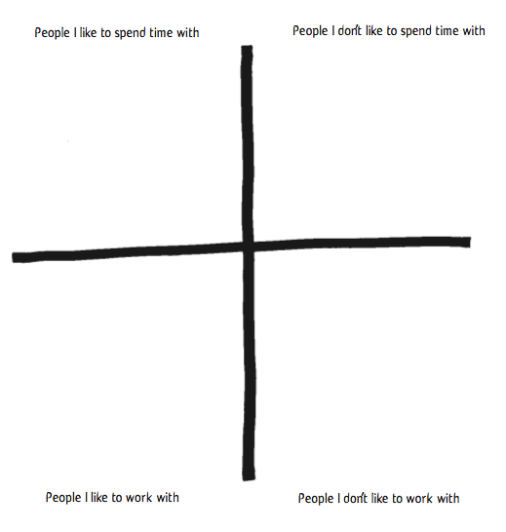
Characteristics of
Characteristics of
Characteristics of
Characteristics of
© TLCPCP 2019 www.tlcpcp.com

Slide 20
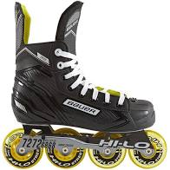
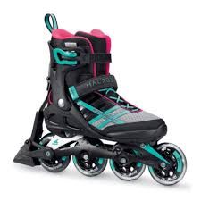

Slide 21
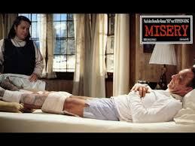
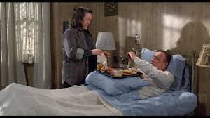
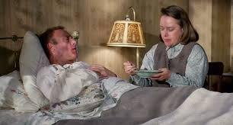
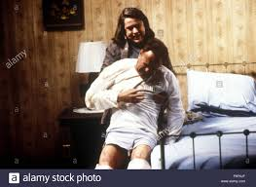

Slide 22
How would you feel?
What would you do?

Slide 23
Learning personality ‘characteristics’ that
need to be Present or Absent in supporters
To learn the characteristics that need to be present, ask: | To learn the characteristics that need to be absent, ask:
Who is closest to the person? Who enjoys spending time with the person? Who helps make good days happen for the person? What characteristics do these people have in common? | Who does the person avoid? Who dislikes spending time with the person? Who makes the person have bad days? What characteristics to these people have in common?
© TLCPCP 2019 www.tlcpcp.com

Slide 25
Matching Staff Supporting: Alan
Support wanted and needed | Skill needed | Personality Characteristics Needed | Shared Common interests (would be nice to have)
Able to get out of the Oldham area e.g. Blackpool, Southport | Full driving license Able to go on motorways To be a car driver | Patience/ Confident | They enjoy visiting places and travel
Someone who will take Alan fishing | Someone who can fish Can handle bait maggots worms | Someone who enjoys peace and quiet Someone who is patient Prepared to sit in the rain Not squeamish | Fishing Angling interest
Someone who can use computers | Basic IT Skills Able to problem solve | Able to share computer knowledge Willingness to learn | Enjoys going on the computer
Someone who enjoys going for a meal | Able to engage with Alan where he wants to go. Enjoys socializing | Someone who likes to go out and about Good communicator | Someone who enjoys a nice meal in a pub/restaurant/cafe

Slide 27
Person-Centred Reviews
Person-Centered Reviews Video

Slide 28
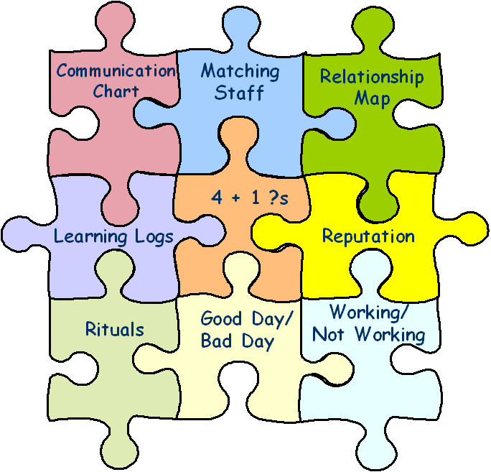
Learning Wheel
What needs to stay the same?
What needs to change?
WW / WNW
Person-Centred
Description
Action
Planning
PCT Tools
Implementation
& Learning
© TLCPCP 2019 www.tlcpcp.com

Slide 29
4 + 1
What have you tried? 1 | What have you learned? 2 | What are you pleased about? 3 | What are you concerned about? 4
What did you do? When did you do it? Who else was there? | What did you learn from your efforts? | What did you like about what you tried? What went well? What worked for you? | What challenges did you encounter? What didn’t you like about what you tried? What didn’t work for you?
+1 – Given your learning what will you do next?
?
?
© TLCPCP 2019 www.tlcpcp.com

Slide 30
What we have done to address Liz’s malnourishment
What have we TRIED? | What have we LEARNED? | What are we PLEASED ABOUT? | What are we CONCERNED ABOUT?
● Healthy frozen meals  Daughter cooking a week’s worth of food for her  High protein shakes 2x a day | She doesn’t like processed food Will almost always eat daughter’s home cooked food Protein shakes work really well  If she is having a really bad day, might only drink one shake at best | ● She is steadily gaining weight  Found at least two options that work for her  She is committed to eating when she can | Stress on daughter to cook and drive 5 hours round trip every weekend Only eating once a day Will lose appetite again if depression comes back
+1: Keep doing protein shakes; find someone local to cook occasionally; keep asking “what did you eat today, not just “did you eat today?”
© TLCPCP 2019 www.tlcpcp.com

Slide 31
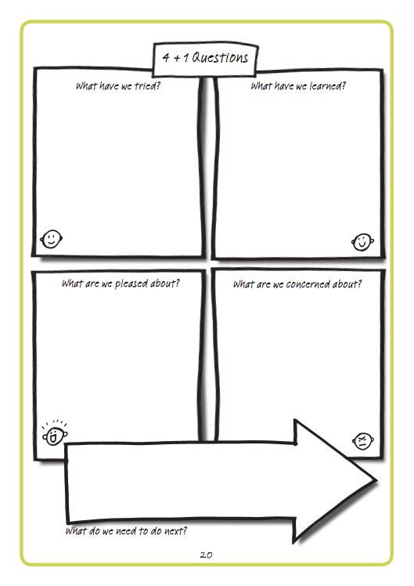

Slide 32
4 + 1
During our time together these last 5 sessions …
?
?
What have you tried? 1 | What have you learned? 2 | What are you pleased about? 3 | What are you concerned about? 4
+1 – Given your learning what will you do next?
© TLCPCP 2019 www.tlcpcp.com

Slide 33
Practical application
Working/Not Working
use this to evaluate a current situation with someone you support, create action around what needs to stay the same and what needs to change
Learning Log
Create a learning log to use for learning around a specific activity or for daily logs
Matching
How can you use this tool to explore the supports someone wants and who the best match would be?
Add ideas to your Action Plan in your workbook
Feedback on Slack

Slide 34
First follower video

